Slide 1






Slide 2
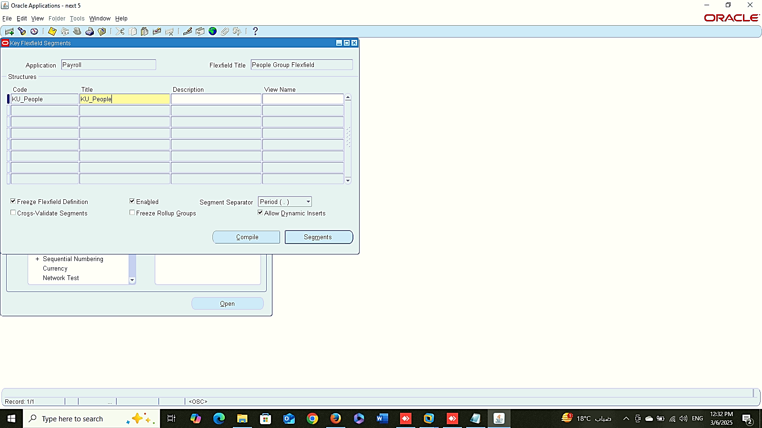
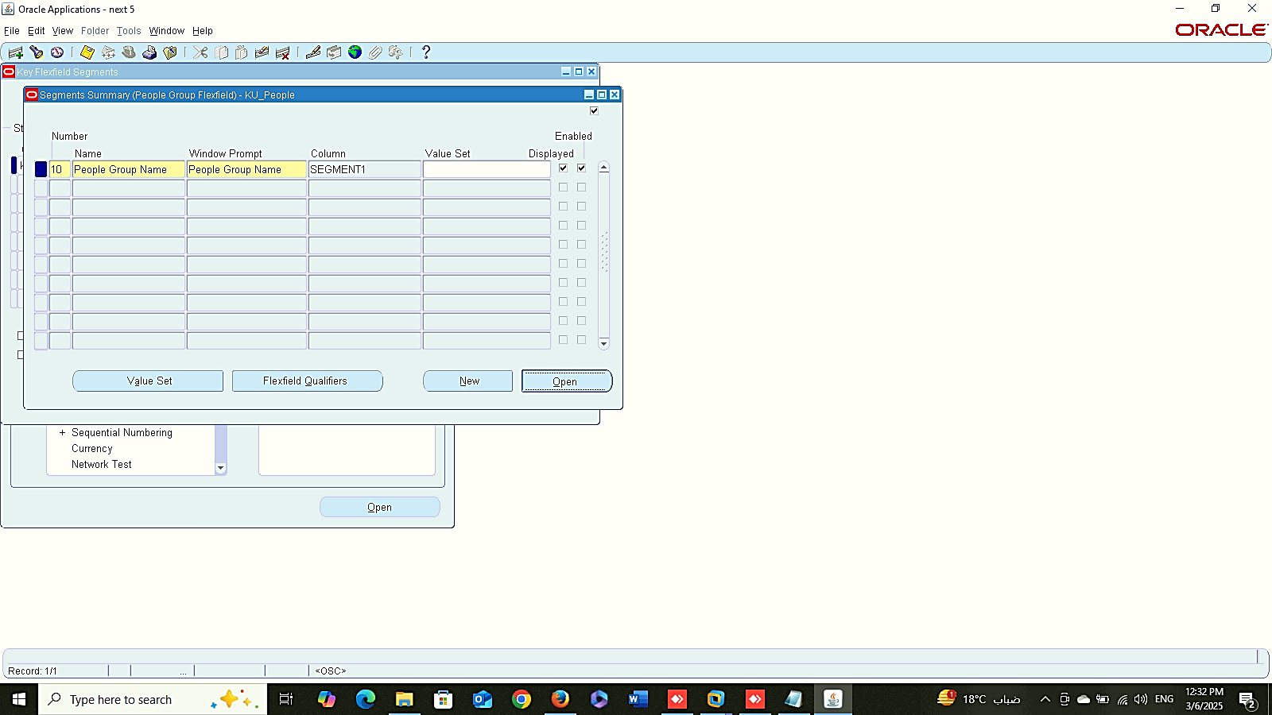
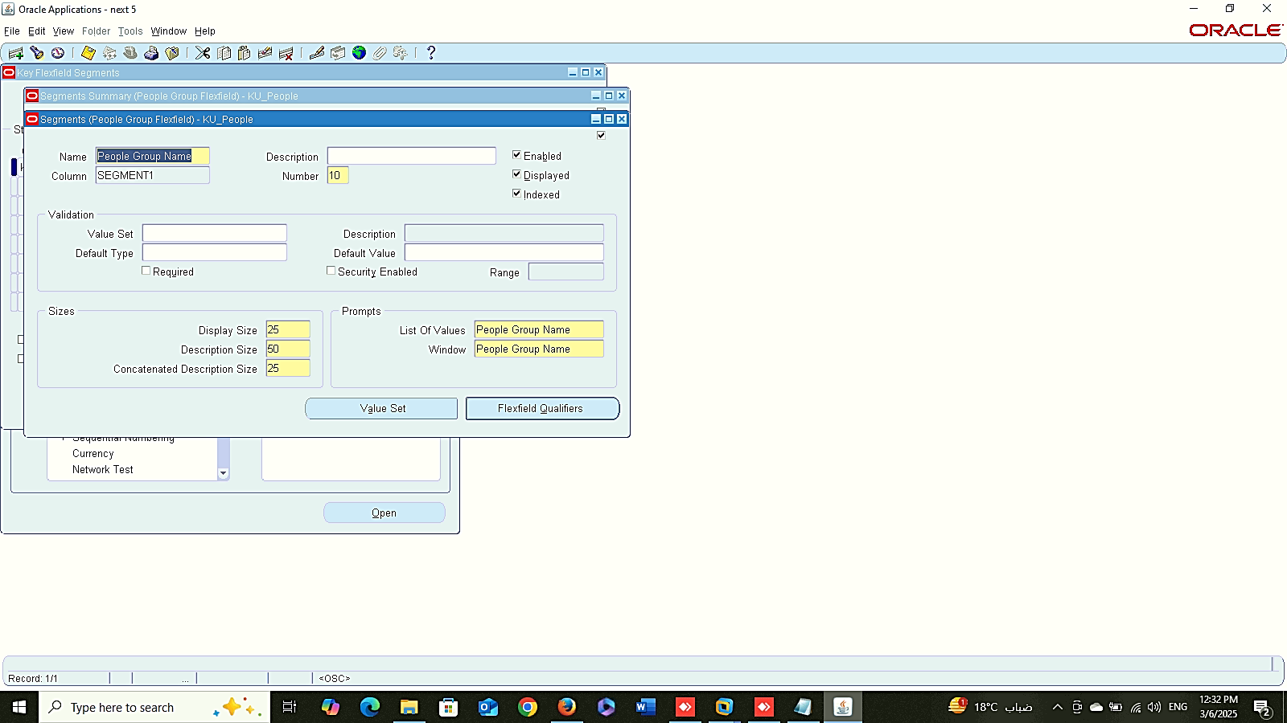
1
2
Finance Management (Payroll)
People Group
system administrator > Application > Payroll > FLEXFIELD > PEOPLE GROUP
3

Slide 3

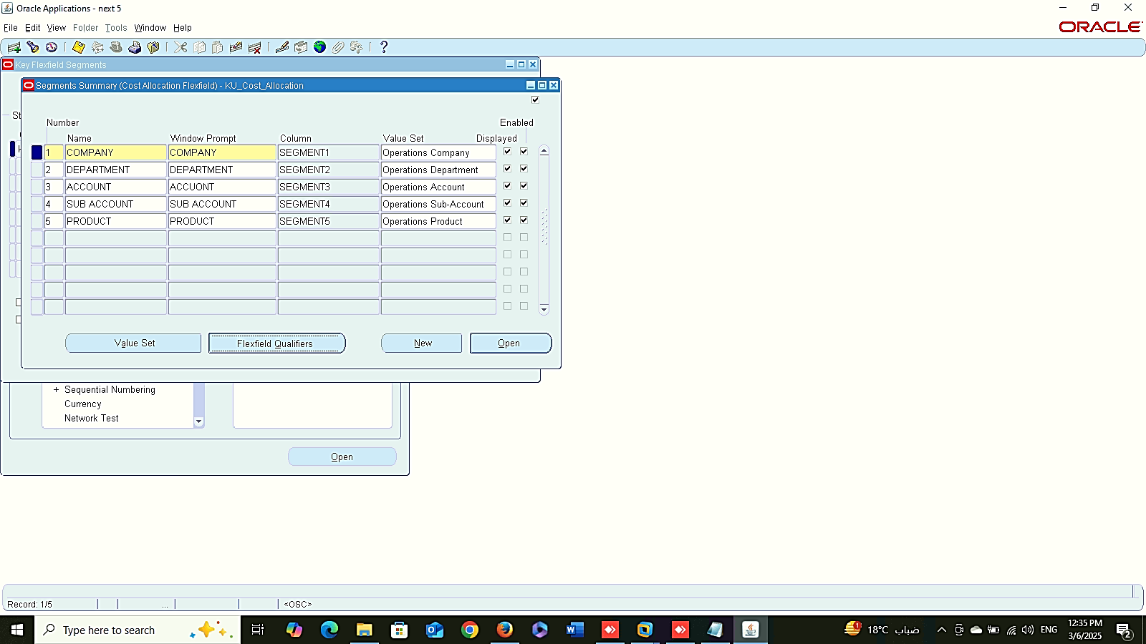
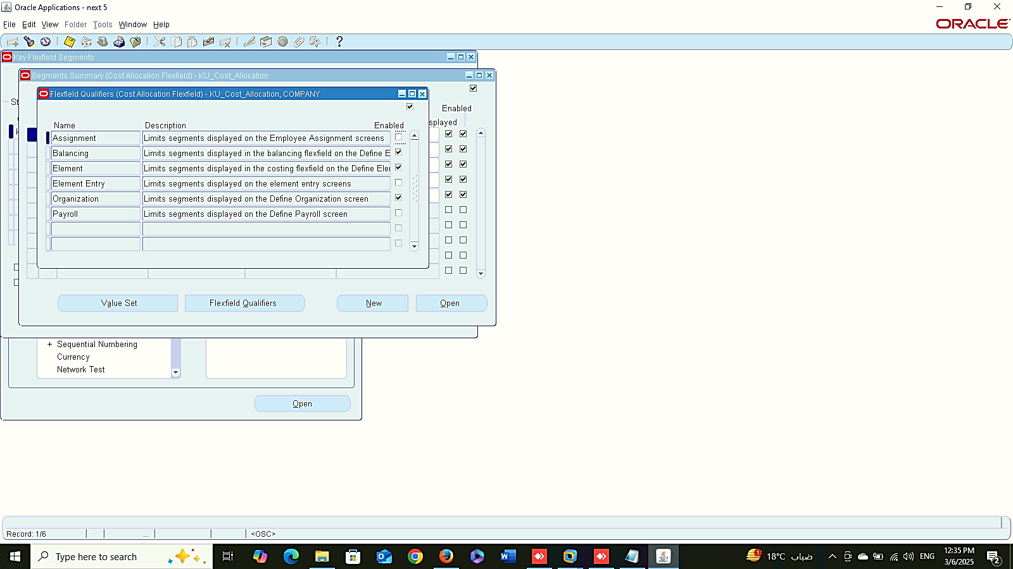
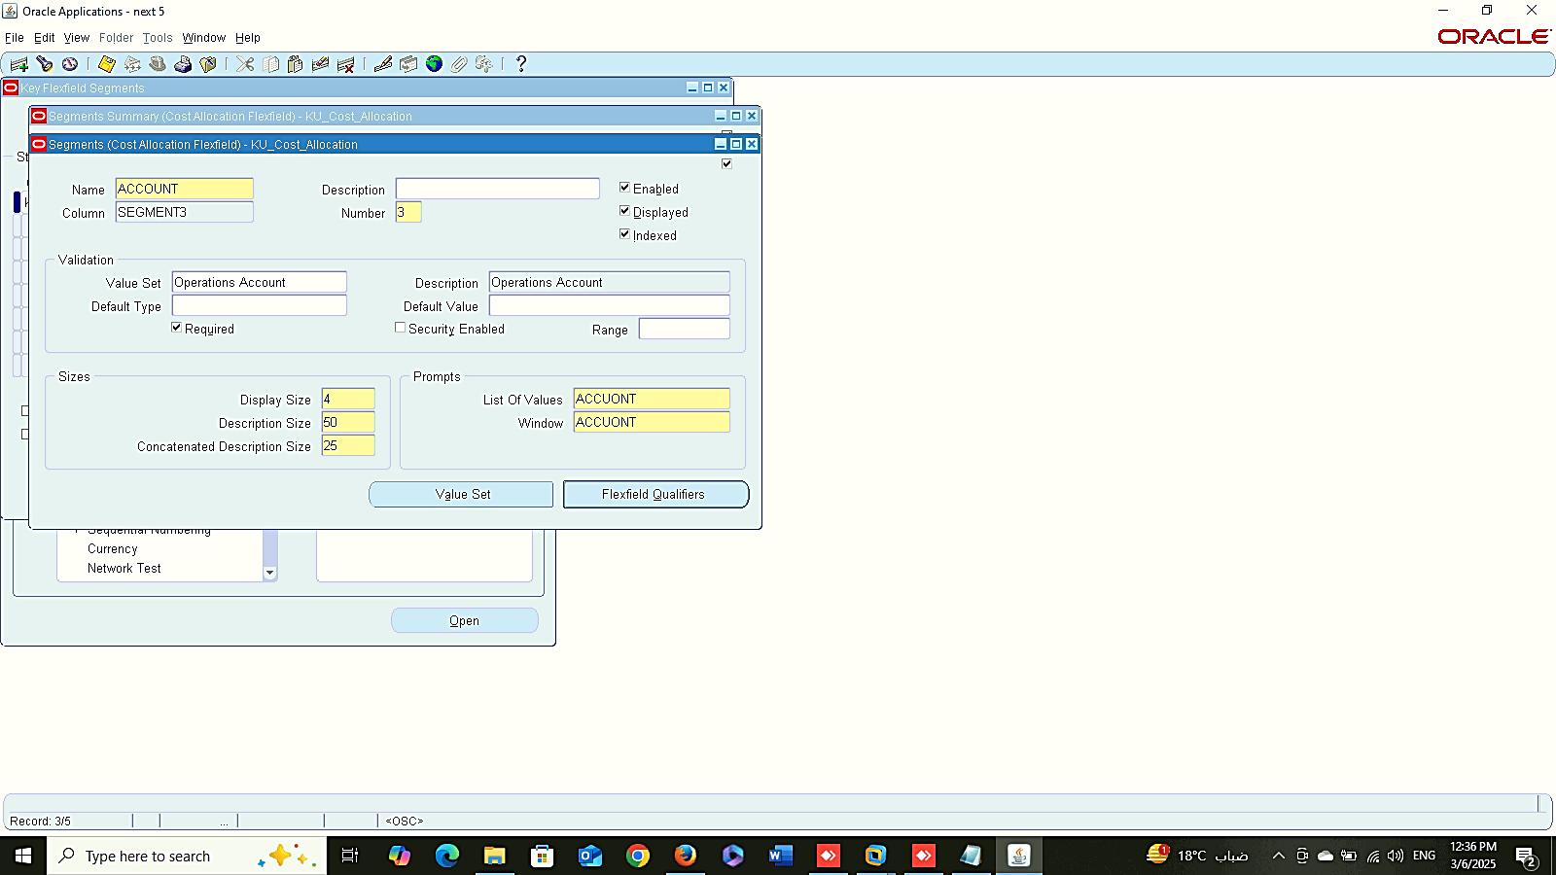
1
2
Finance Management (Payroll)
Cost Allocation
system administrator > Application > Payroll > FLEXFIELD > COST ALLOCATION
3
4

Slide 4
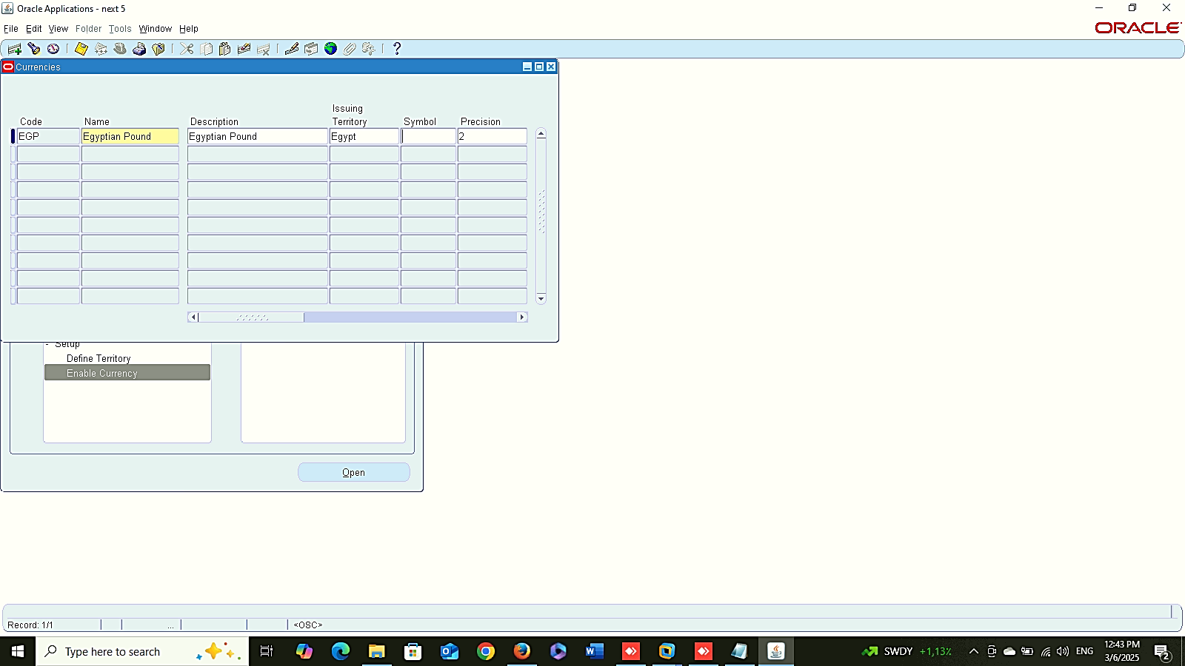
Finance Management (Payroll)
Enable Currency:
Global HRMS MANAGER > SETUP > ENABLE CURRENCY

Slide 5
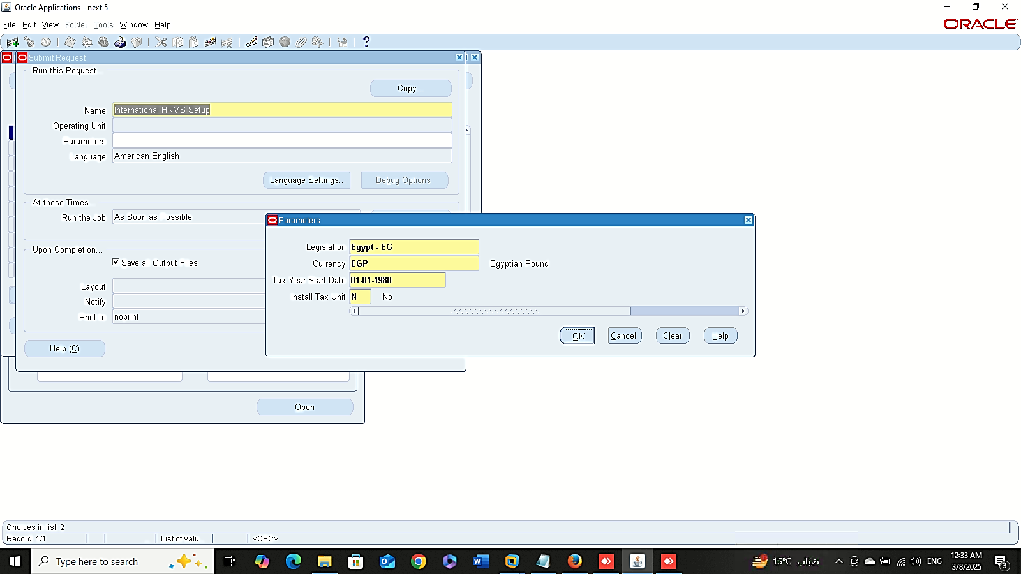
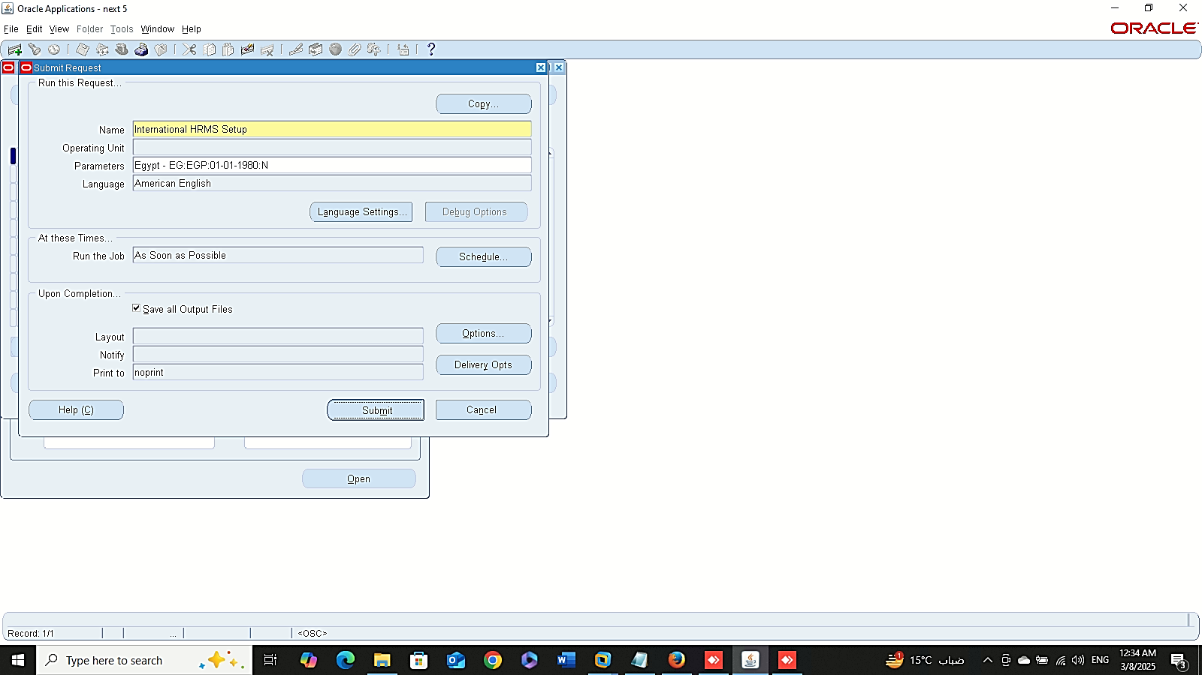
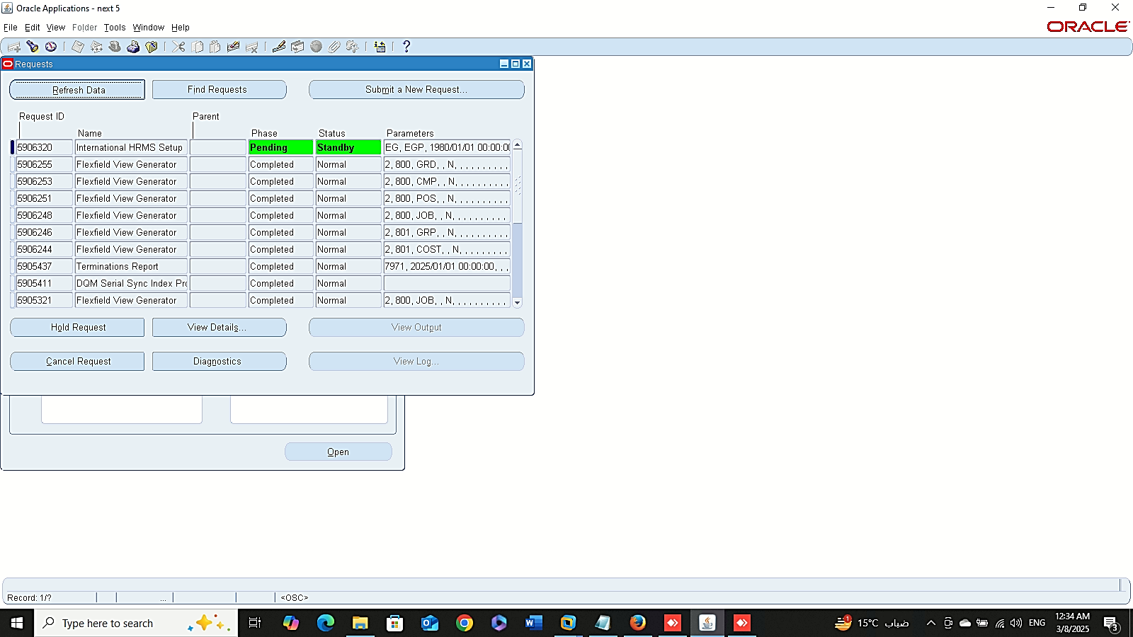
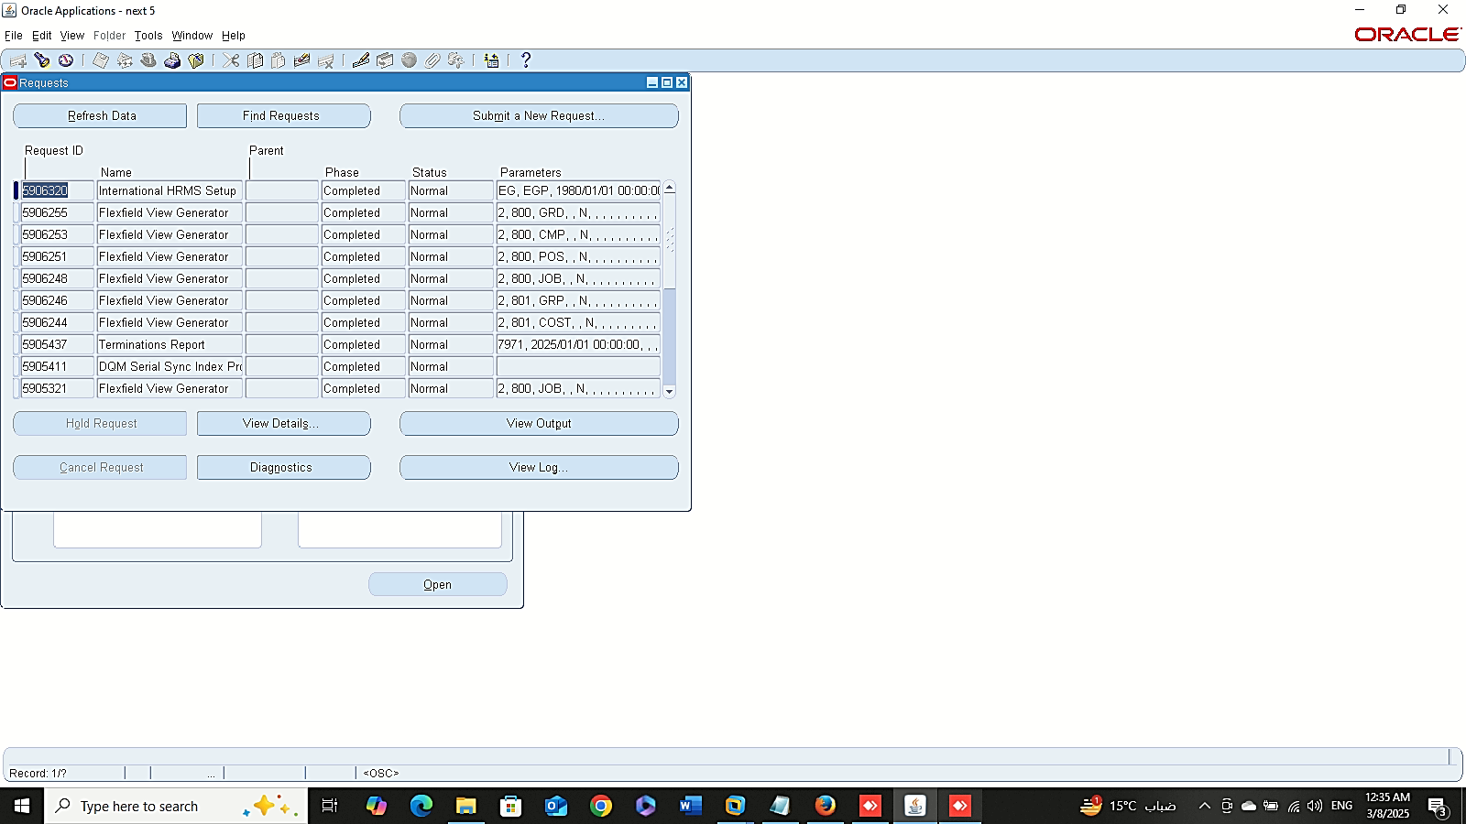
1
2
Finance Management (Payroll)
Run Request:
Global HRMS MANAGER > VIEW > REQUESTS > SUBMIT A NEW REQUEST
3
4

Slide 6
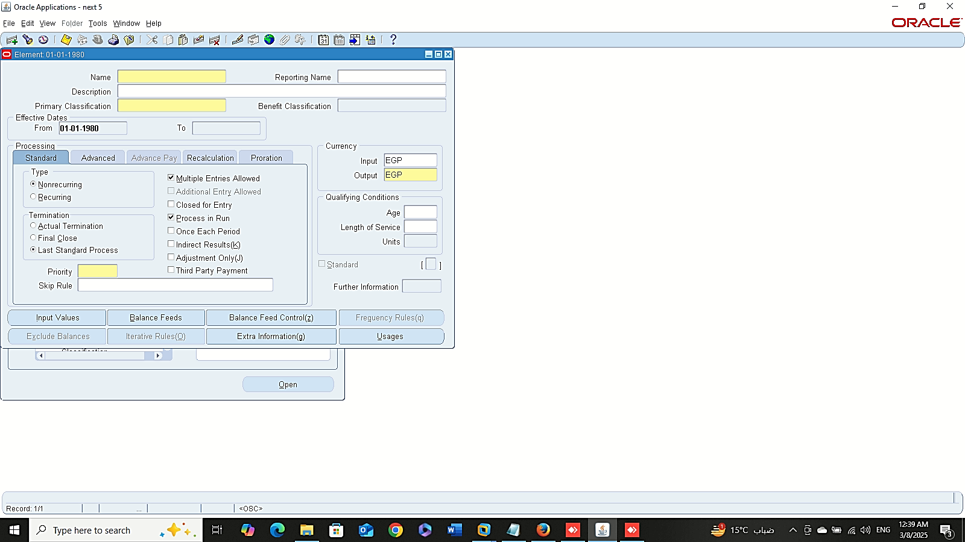
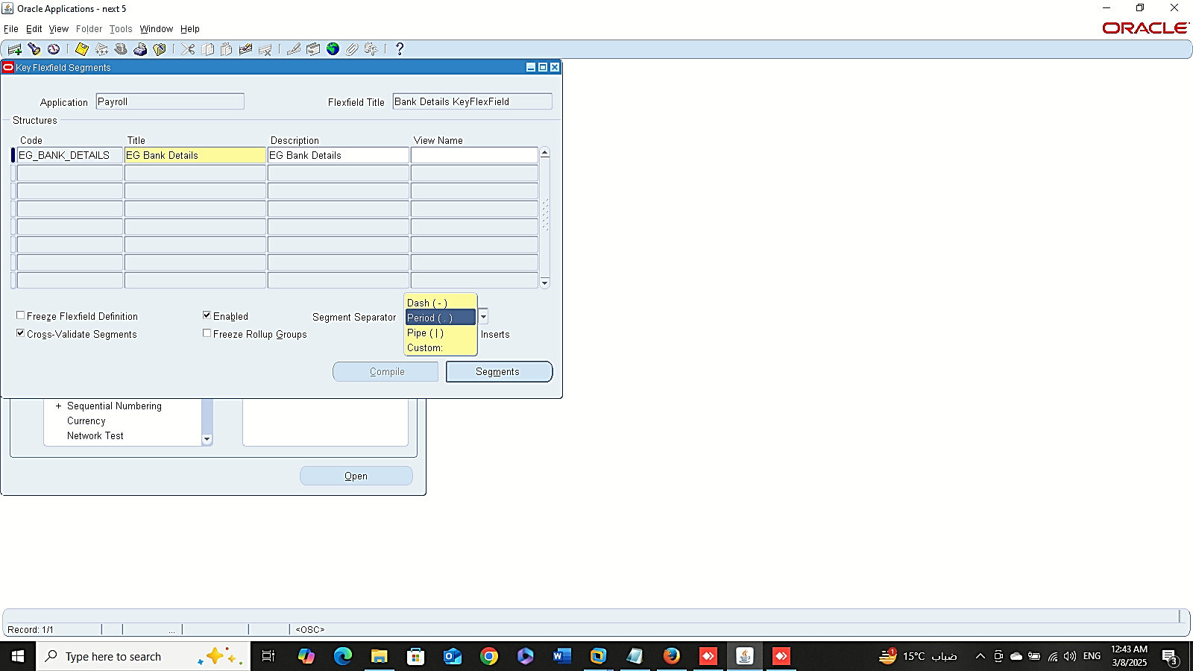
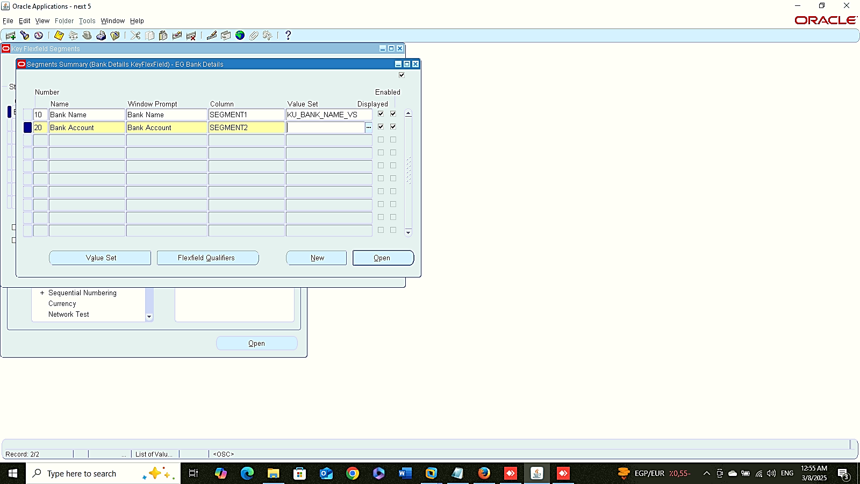
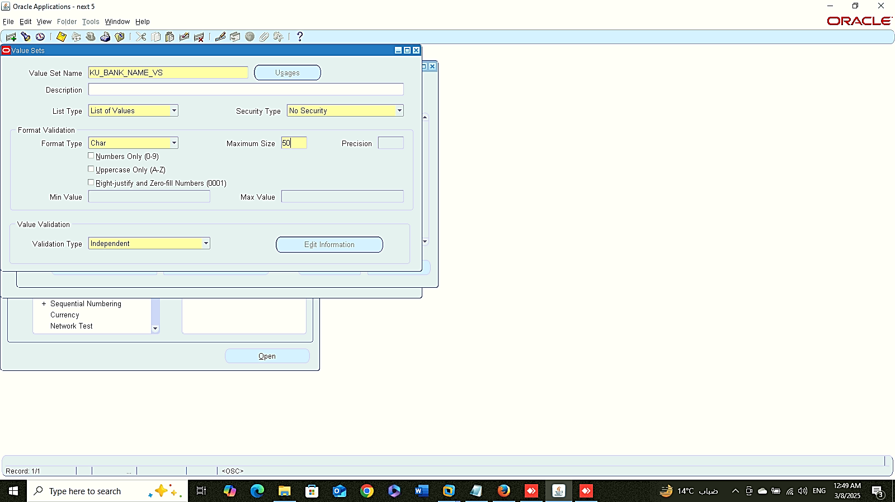
Element Description
Bank Details
1
Finance Management (Payroll)
Element Description:
Global HRMS MANAGER > TOTAL COMPENSATION > BASIC > ELEMENT DESCRIPTION
Bank Details:
System administrator > Application > FLEXFIELD > KEY > SEGMENTS
Application : Payroll
Flex-field Title: Bank Details Flex-field
Bank Details
Bank Details
2
3

Slide 7
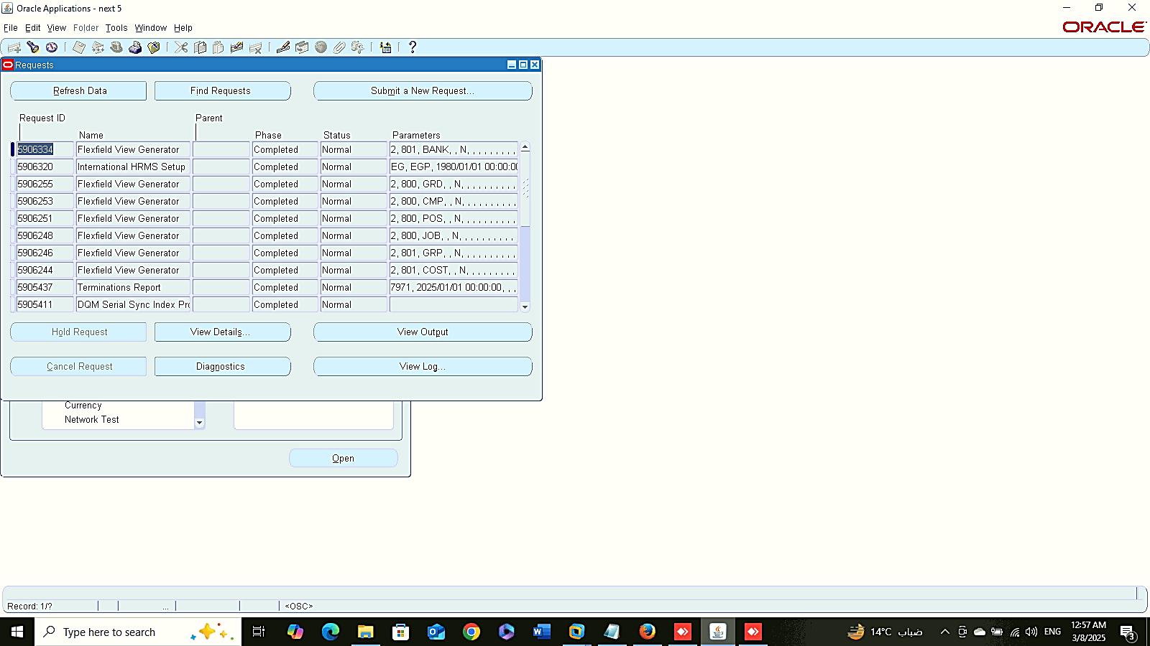
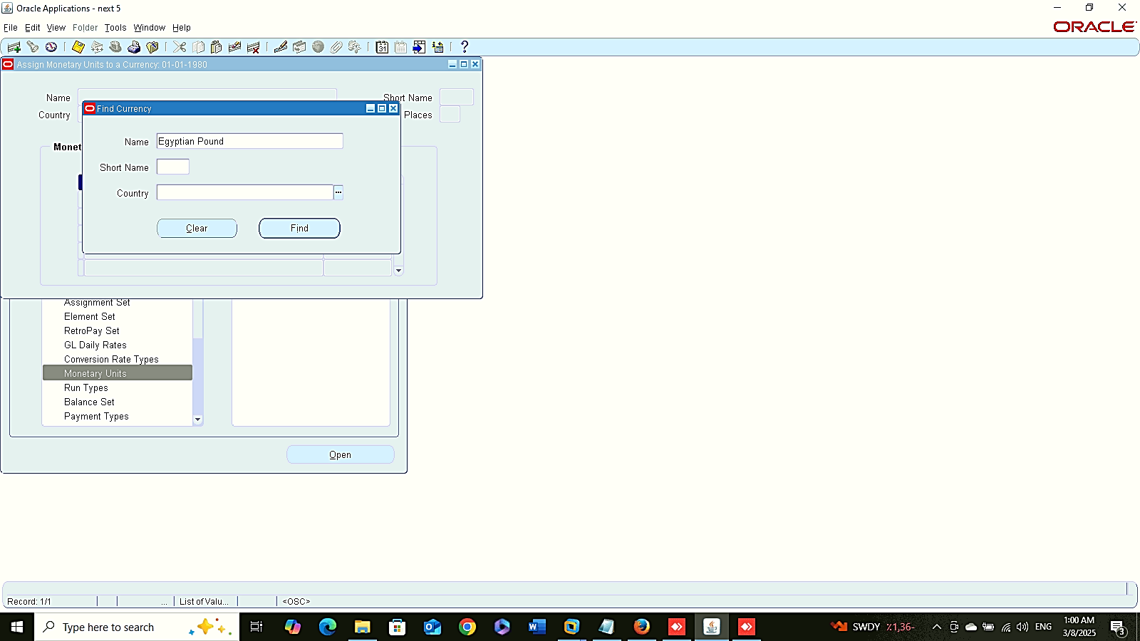
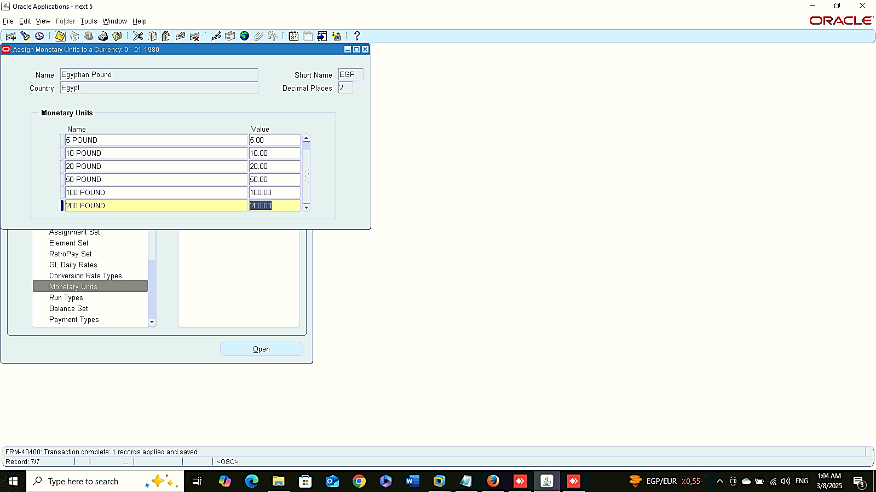
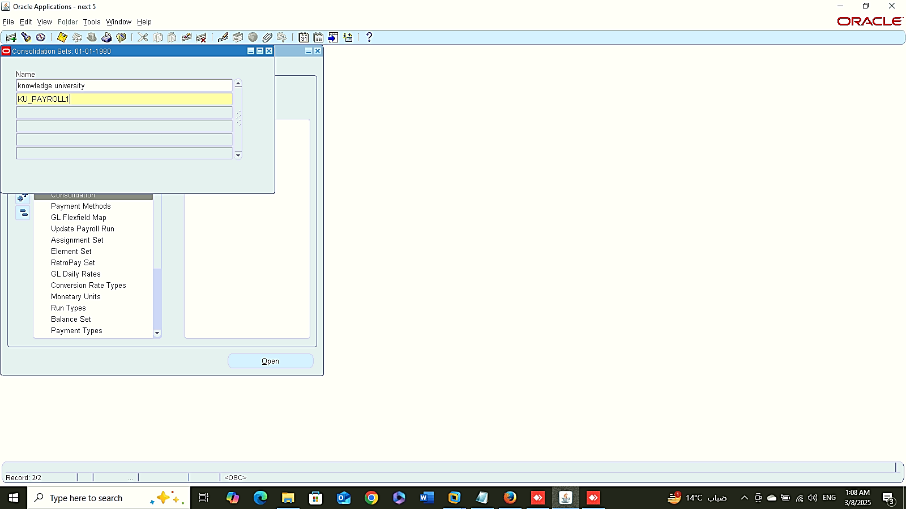
View Request
Monetary Units
1
Finance Management (Payroll)
View Request:
SYSTEM ADMIN> VIEW> REQUESTS > FIND
Monetary Unit:
GLOBAL HRMS MANAGER> PAYROLL > MONETATRY UNITS
Consolidation:
GLOBAL HRMS MANAGER> PAYROLL > CONSOLIDATION
Monetary Units
Consolidation
2

Slide 8
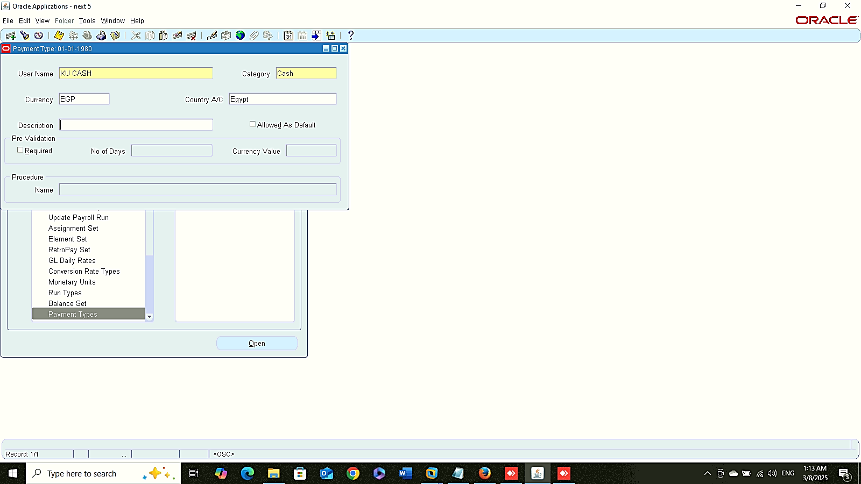

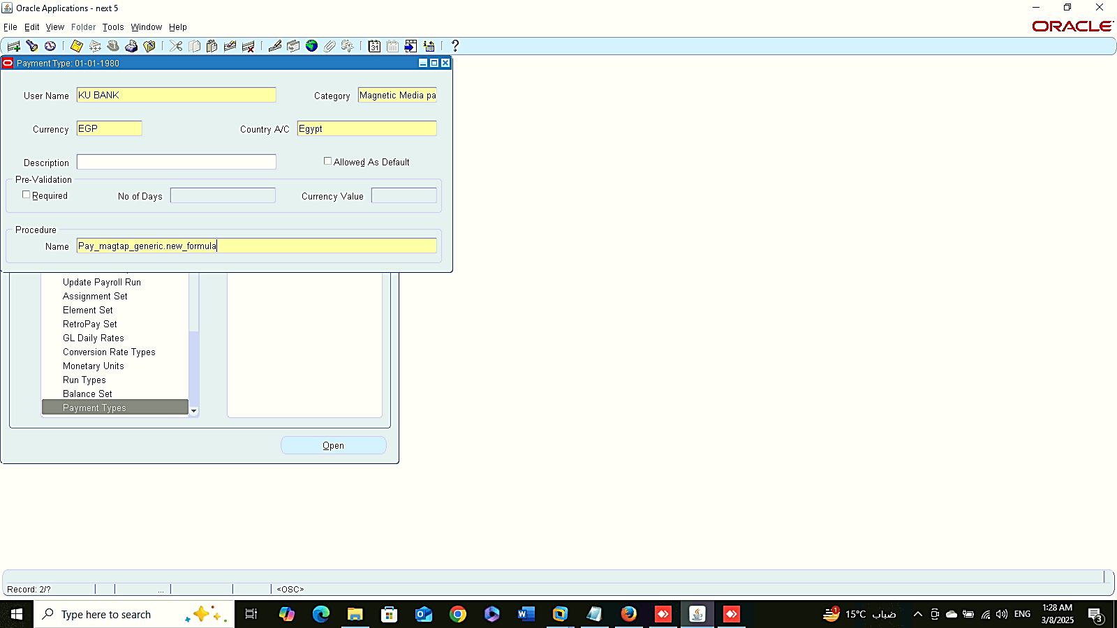
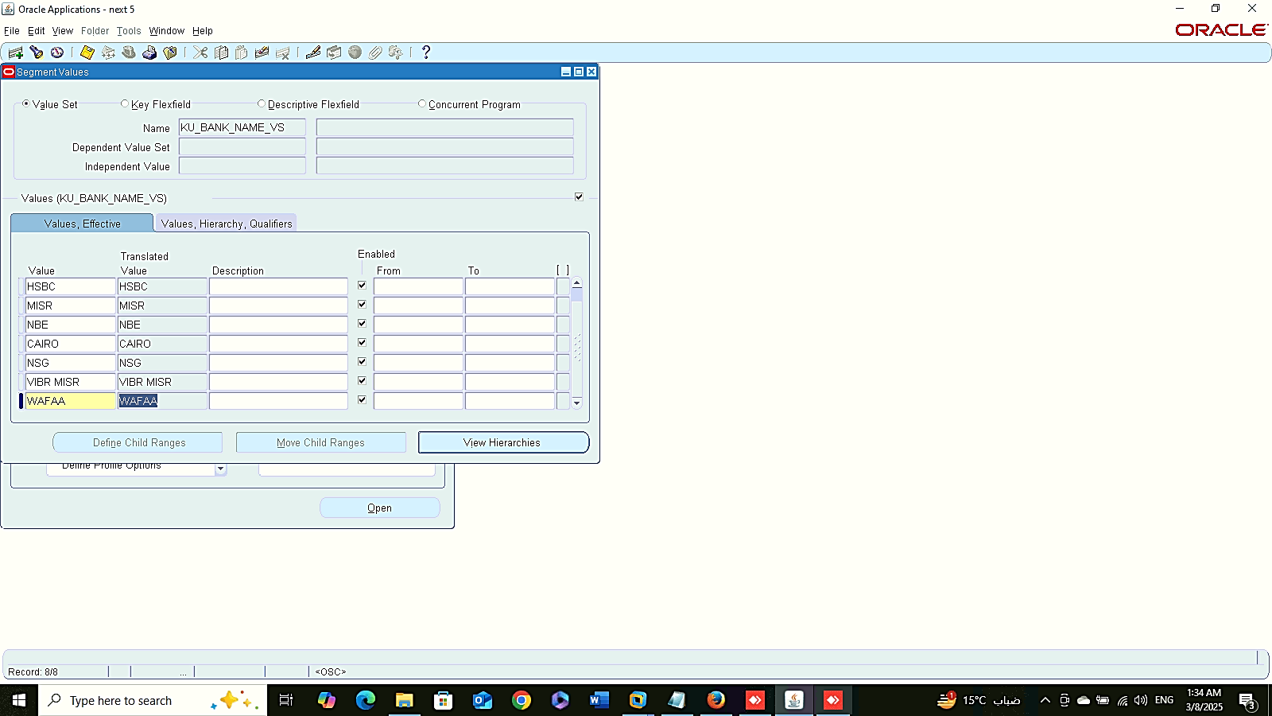
Payment Types
Cash
Check
Bank
Finance Management (Payroll)
Payment Types:
Global HRMS MANAGER > PAYROLL > PAYMENT TYPES
Cash
Check
Bank
Add Value Set inside Value:
SYSTEM ADMIN > VALIDATION > VALUE
Add Value Set Inside Value

Slide 9
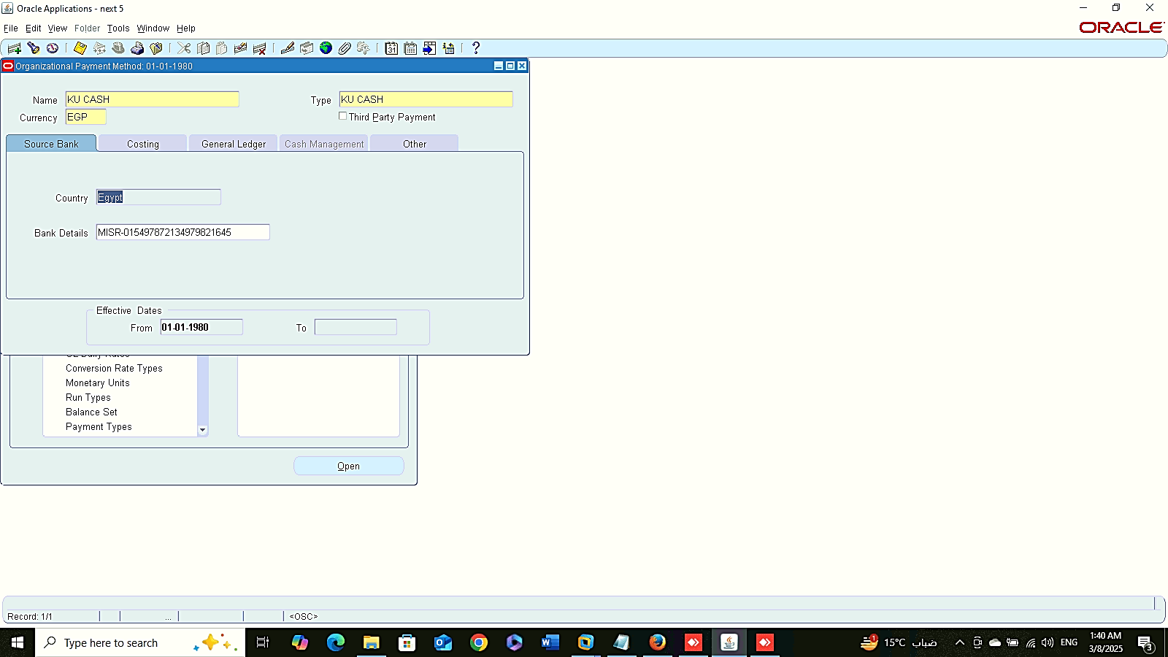
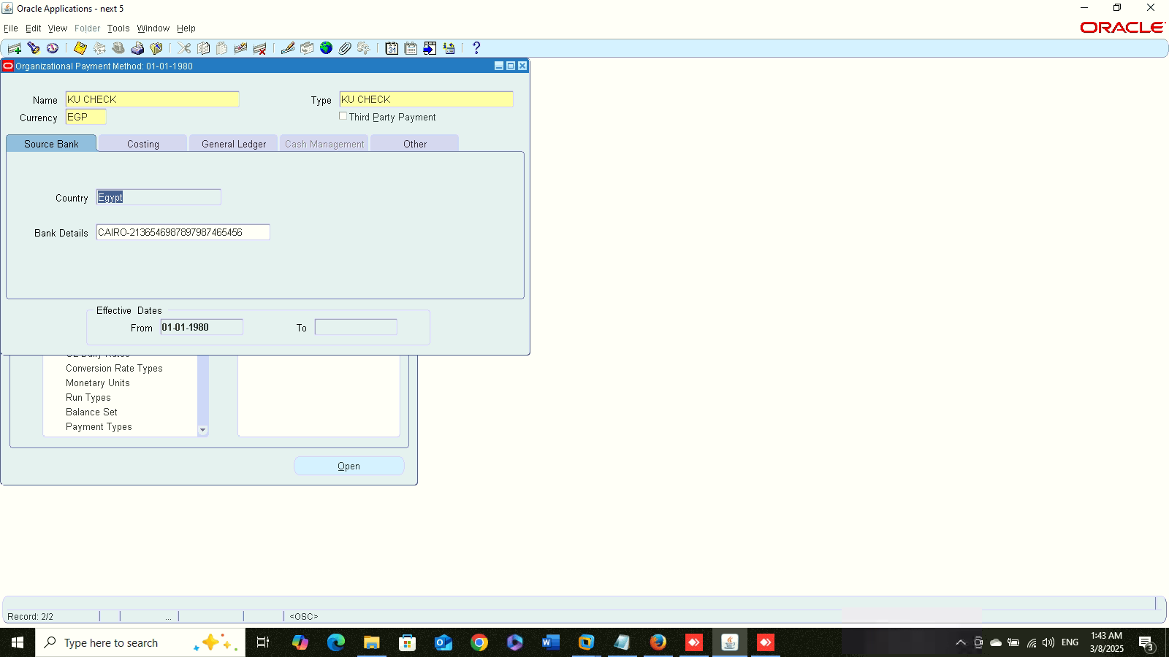
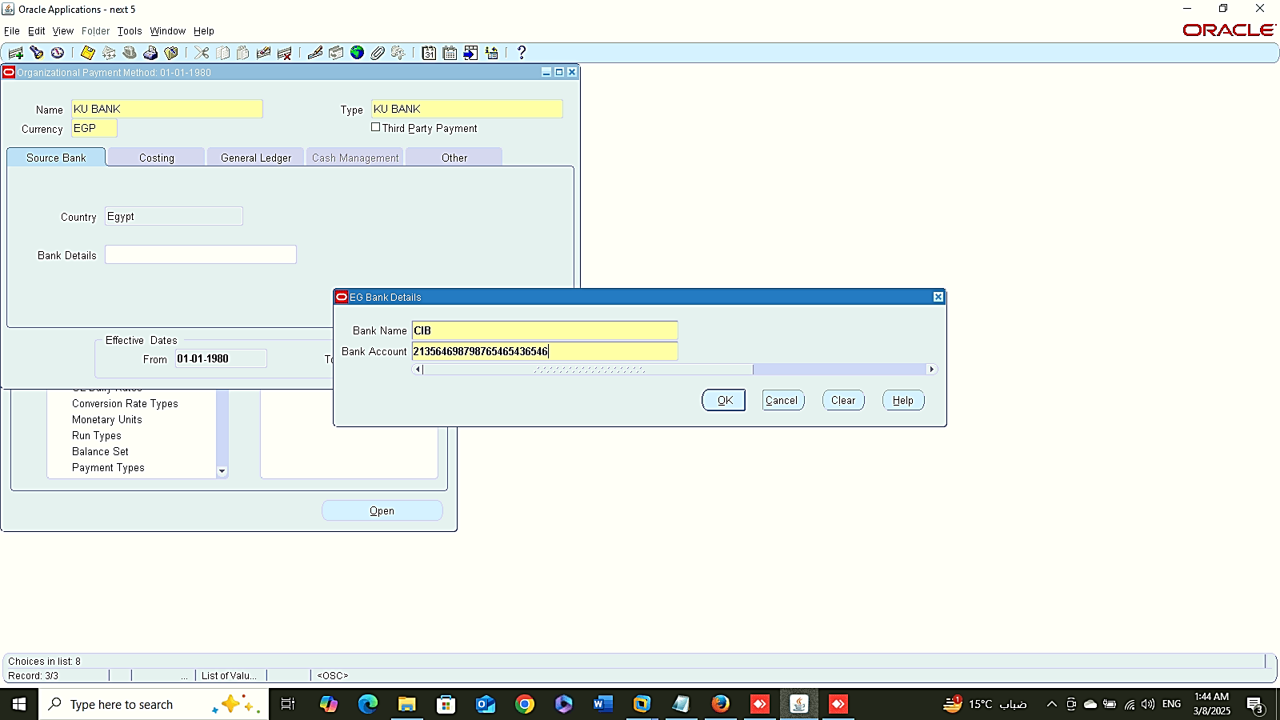
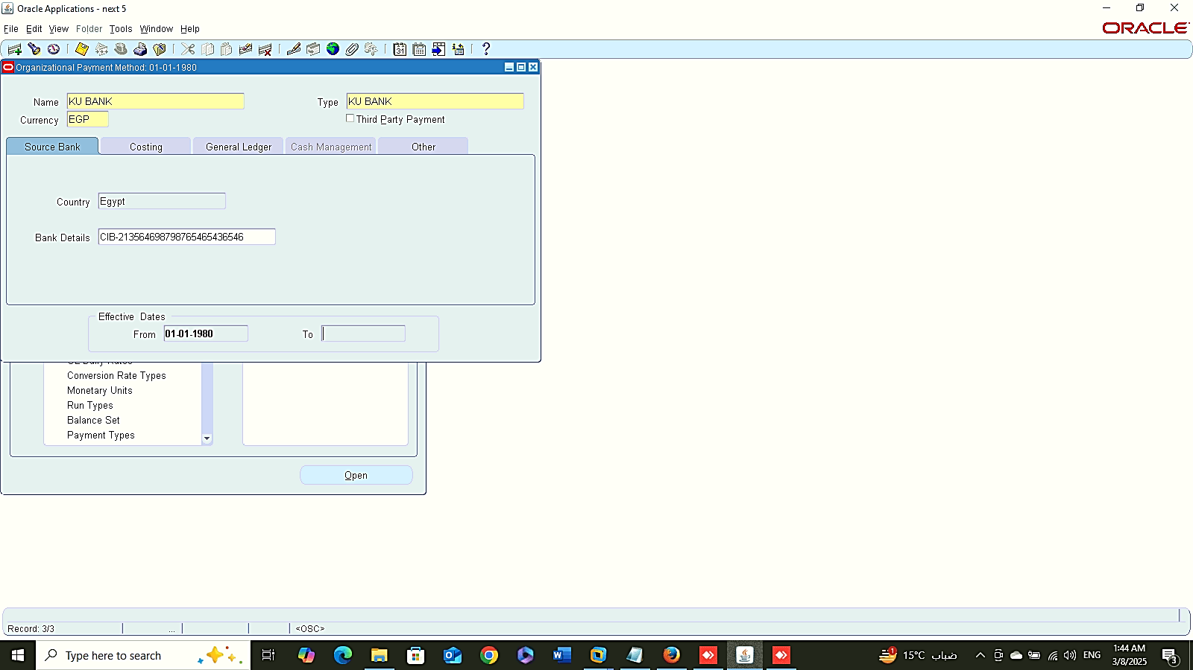
Payment Methods
Cash
Check
Finance Management (Payroll)
Payment Methods:
Global HRMS MANAGER > PAYROLL > PAYMENT METHODS
Cash
Check
Bank
Bank

Slide 10
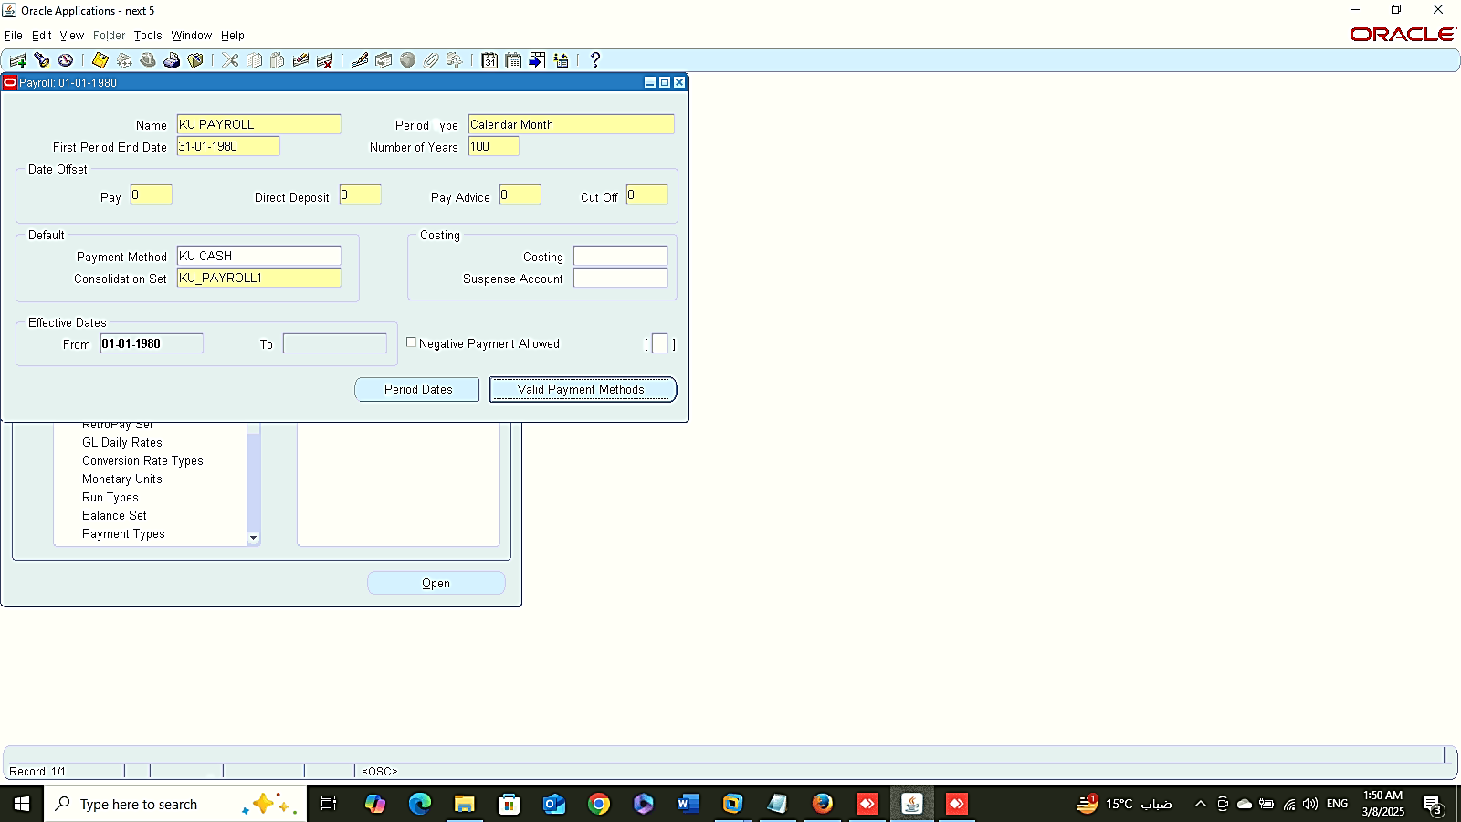
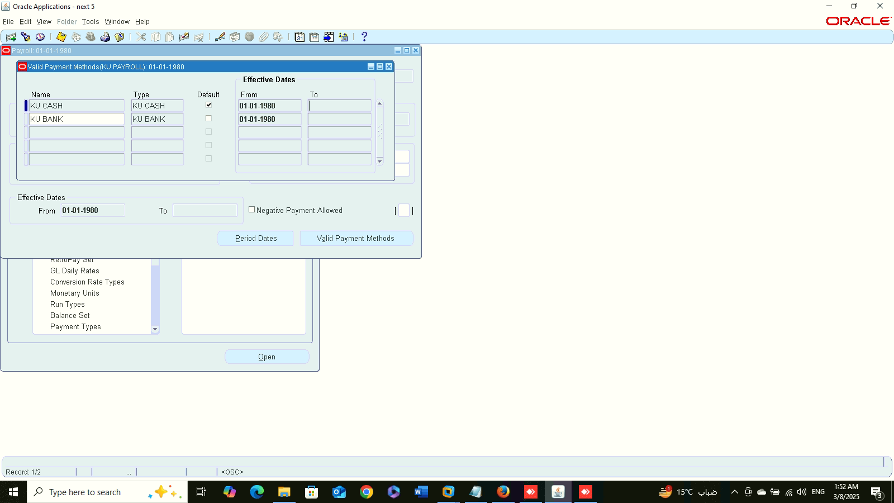
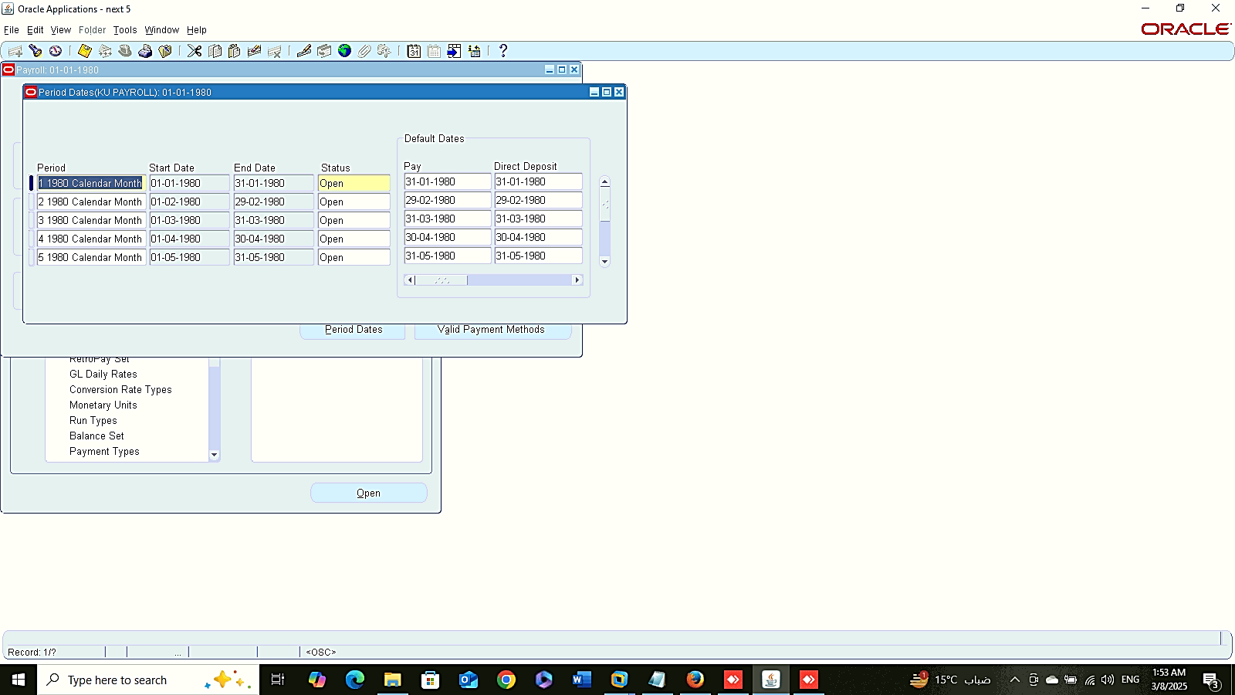
Payroll Description
Valid Payment Method
Finance Management (Payroll)
Payroll:
Global HRMS MANAGER > PAYROLL > DESCRRIPTION
Valid Payment Method
Period Dates
Period Dates

Slide 11
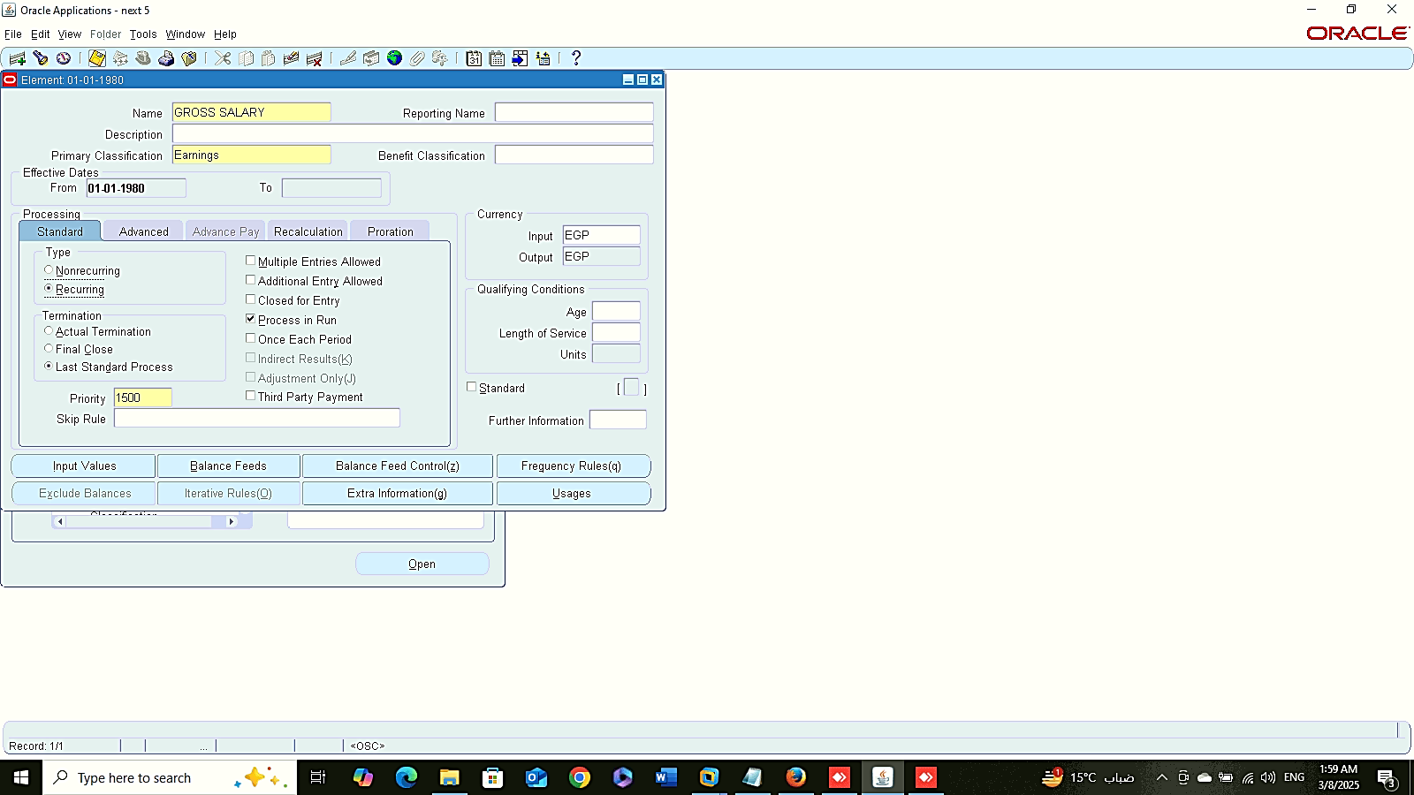
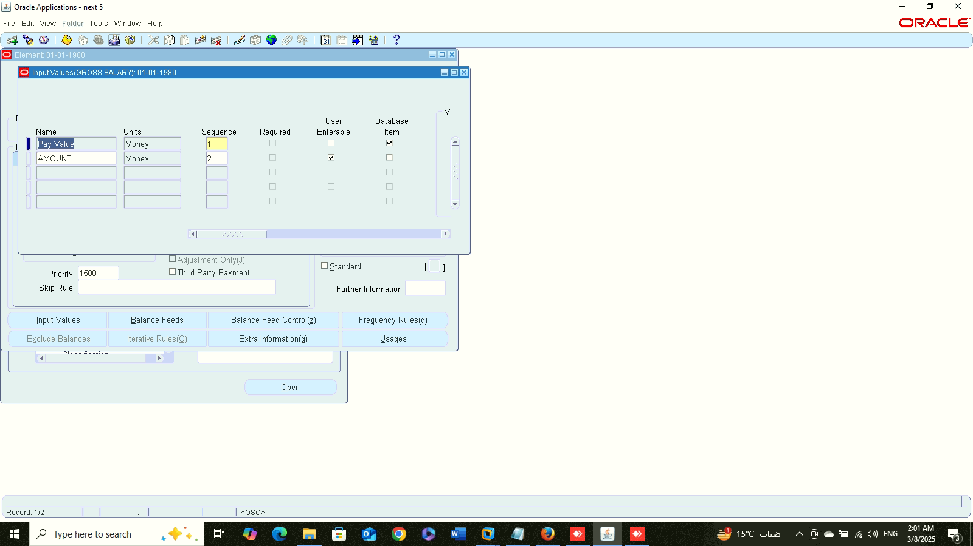
Define Element
Finance Management (Payroll)
Define Elements:
Global HRMS MANAGER > TOTAL COMPENSATION > BASIC > ELEMENT DESCRIPTION
Input Value
Input Value

Slide 12
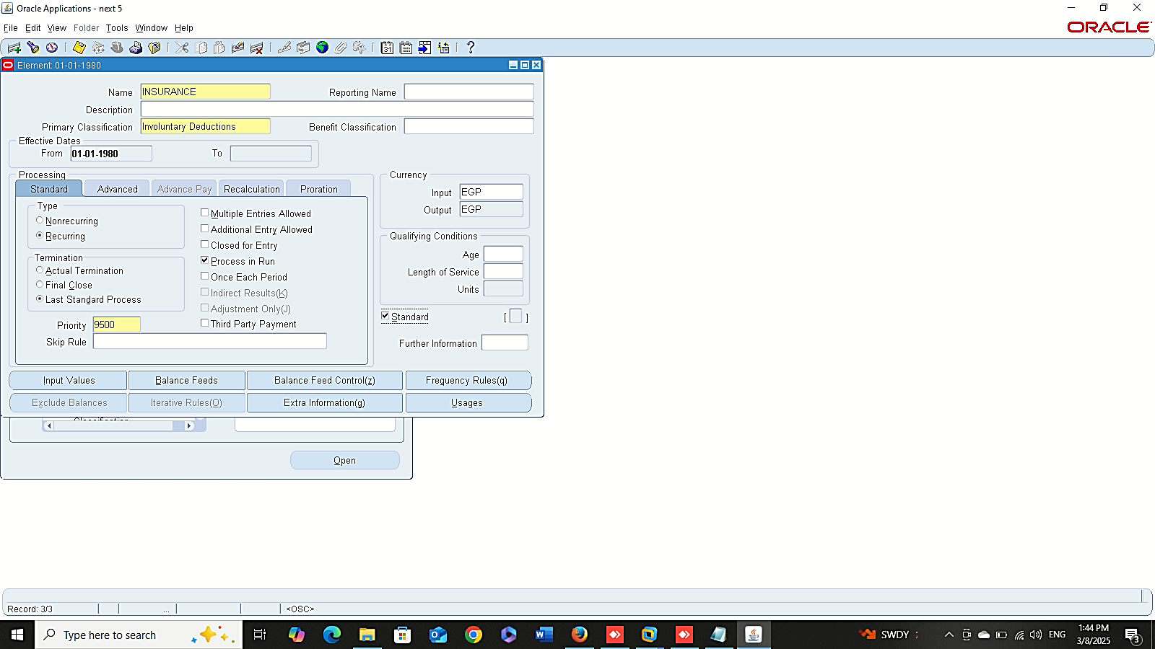
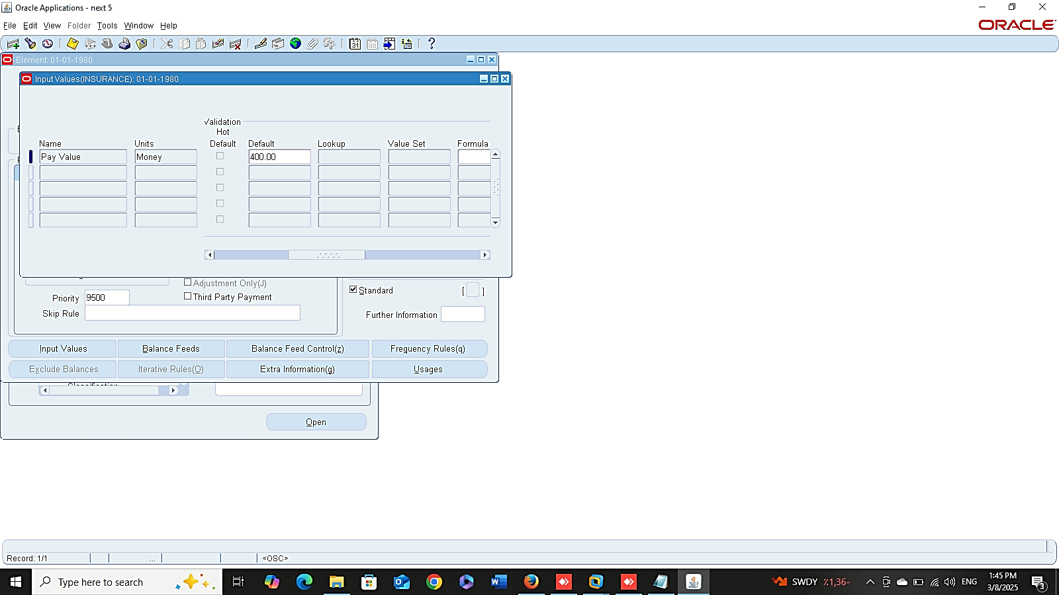


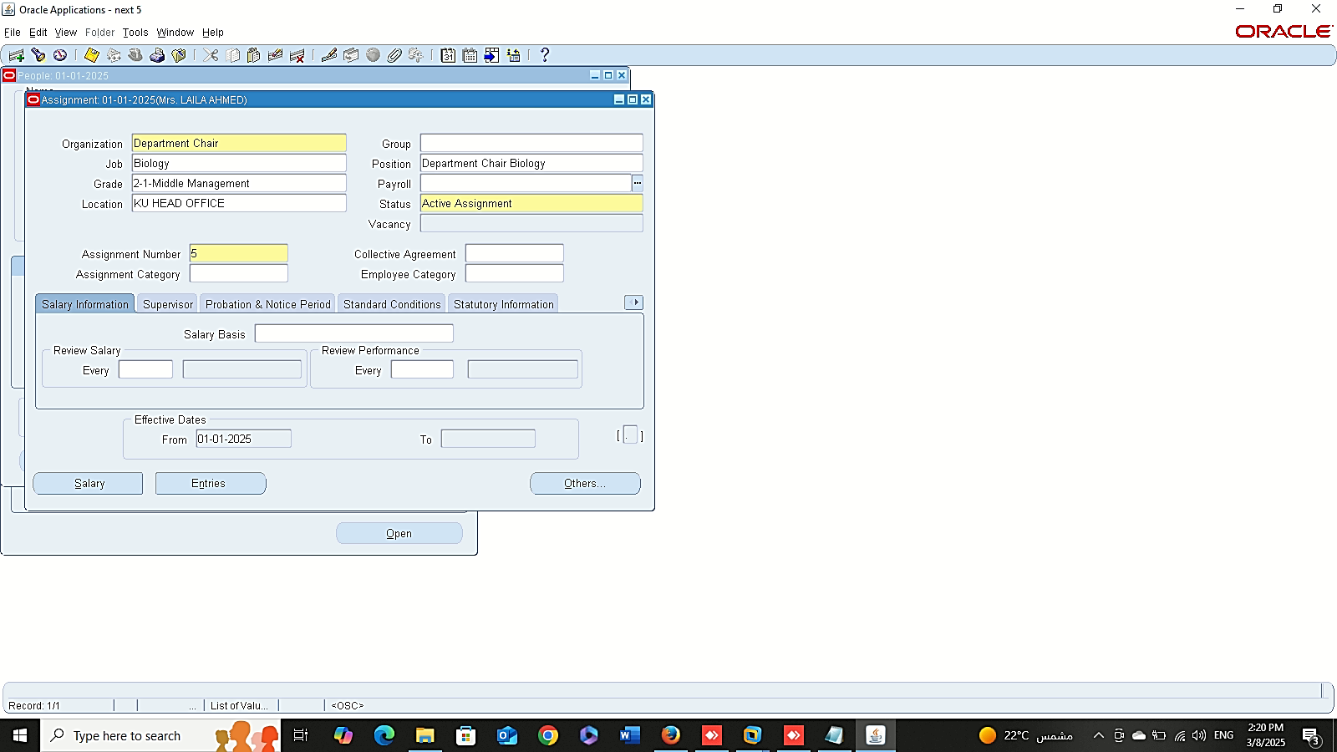
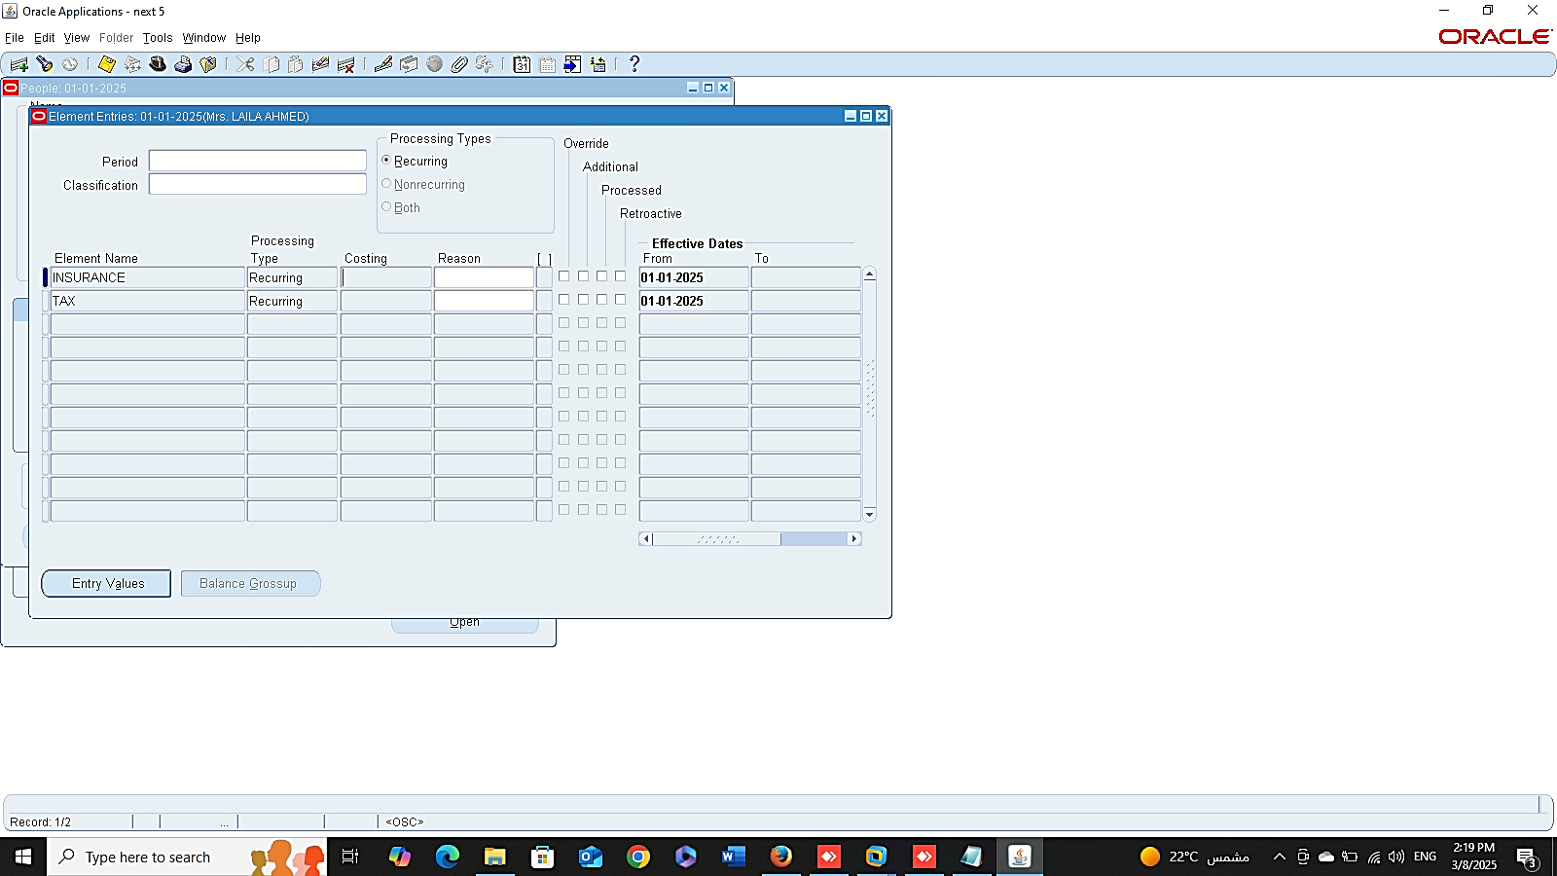
1
2
3
Finance Management (Payroll)
Standard Element
4
5
6

Slide 13
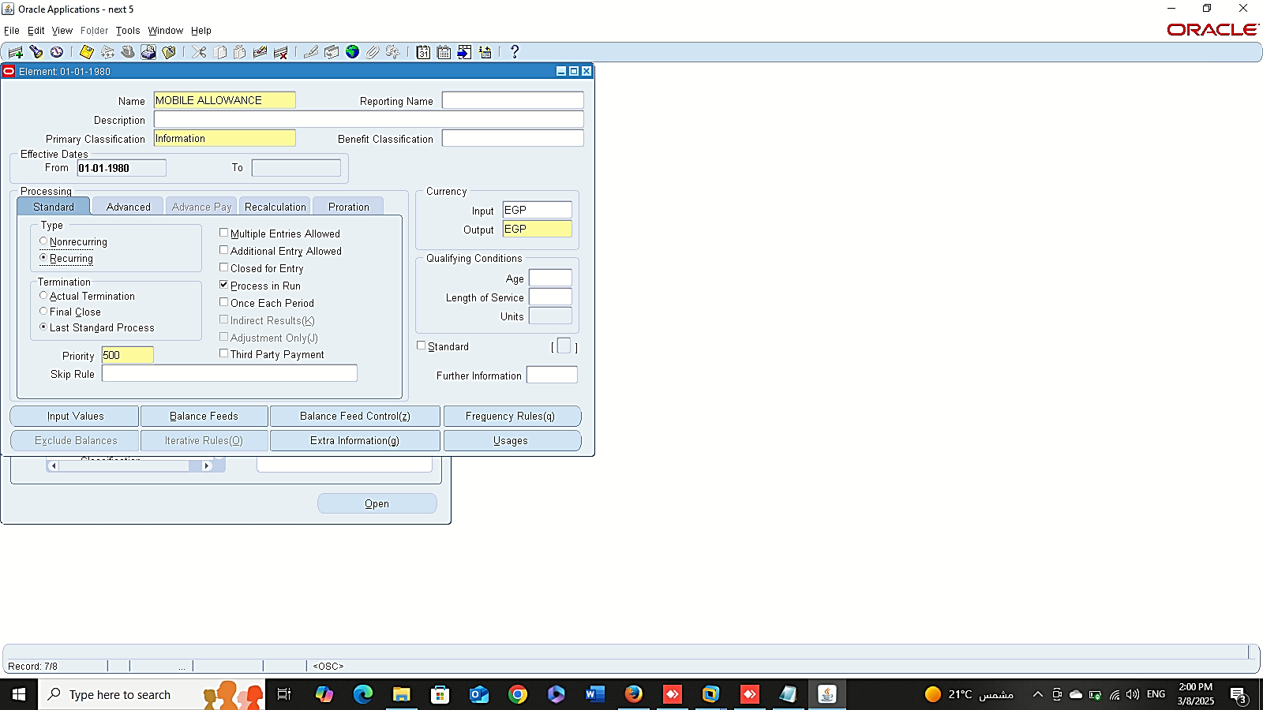
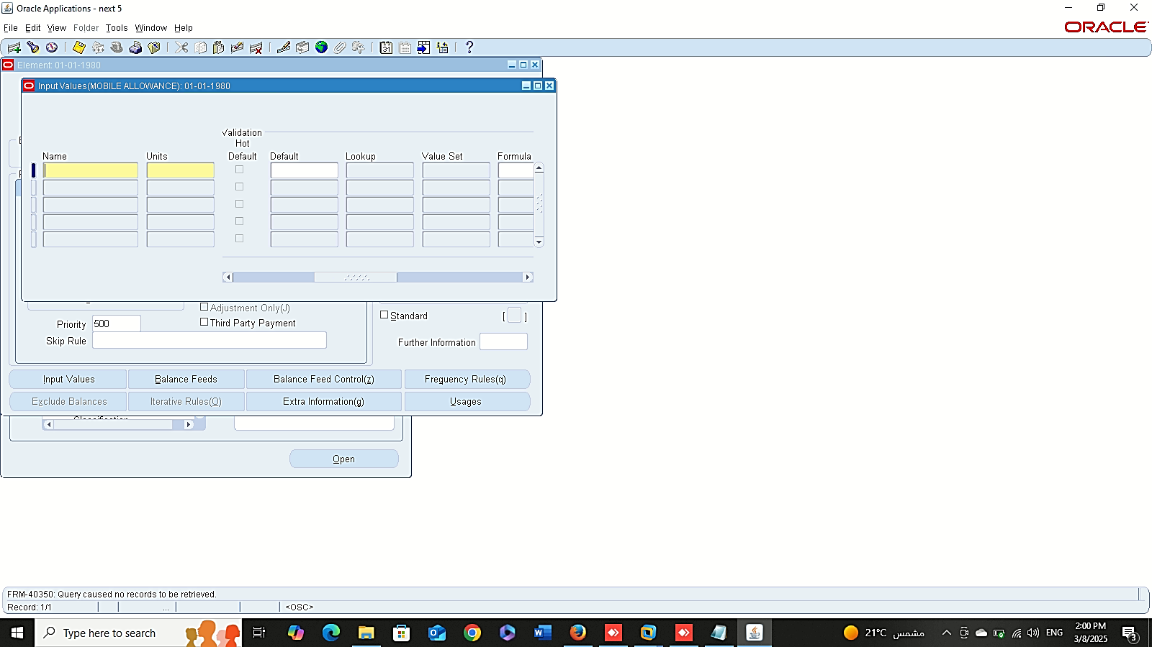
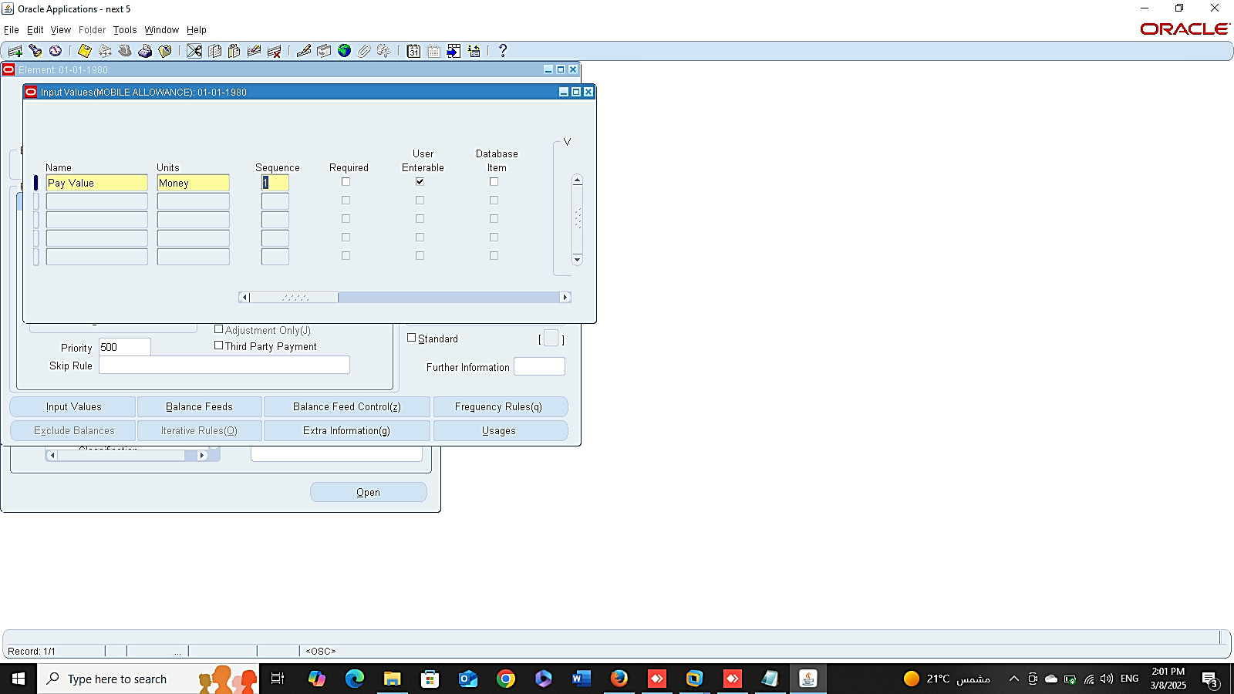
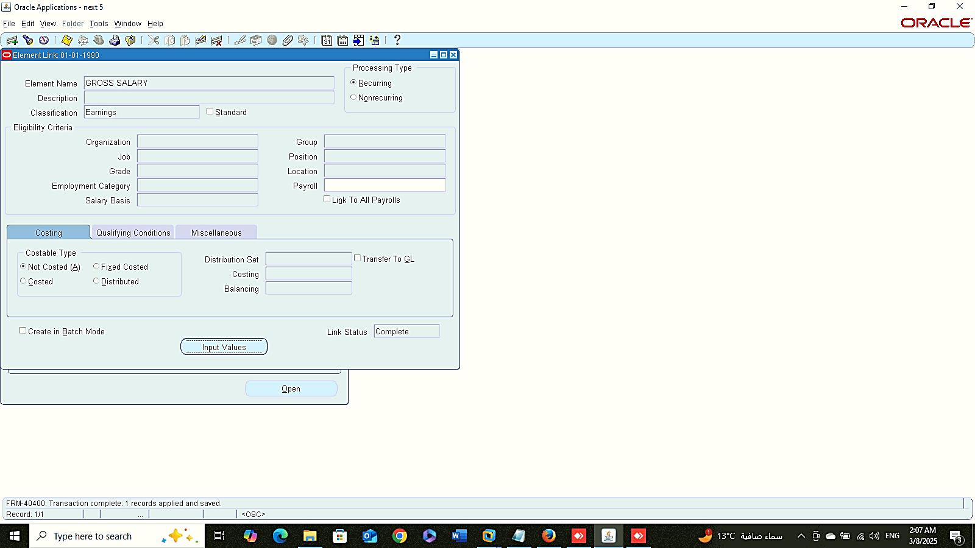
Classification Information
1
2
3
Finance Management (Payroll)
Classification Information
Link Elements:
Global HRMS MANAGER > TOTAL COMPENSATION > BASIC> LINK
Link Elements

Slide 14
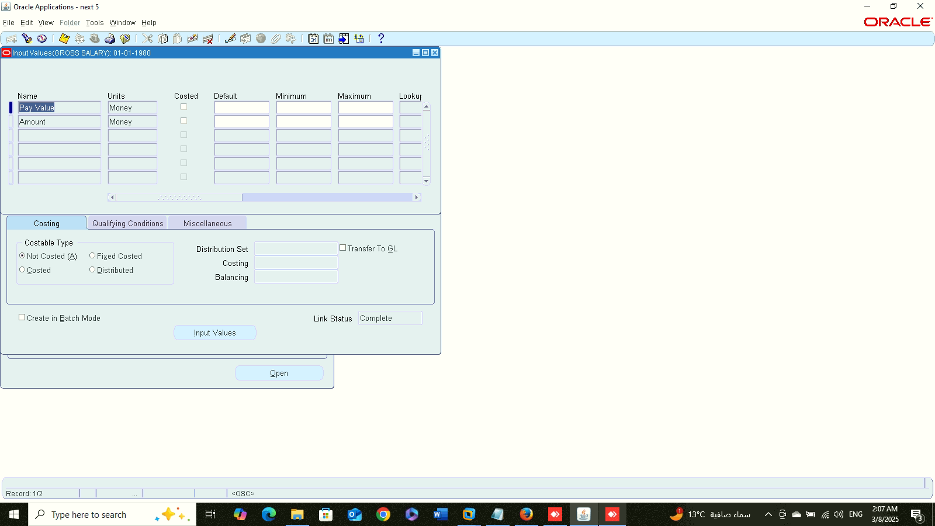
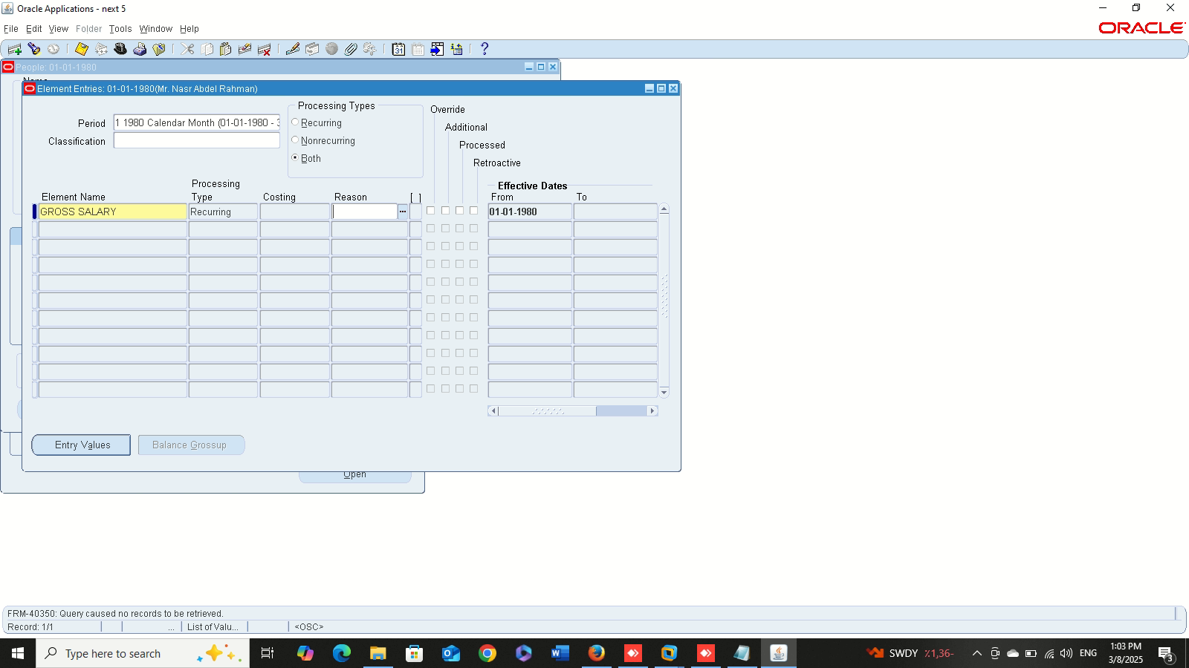
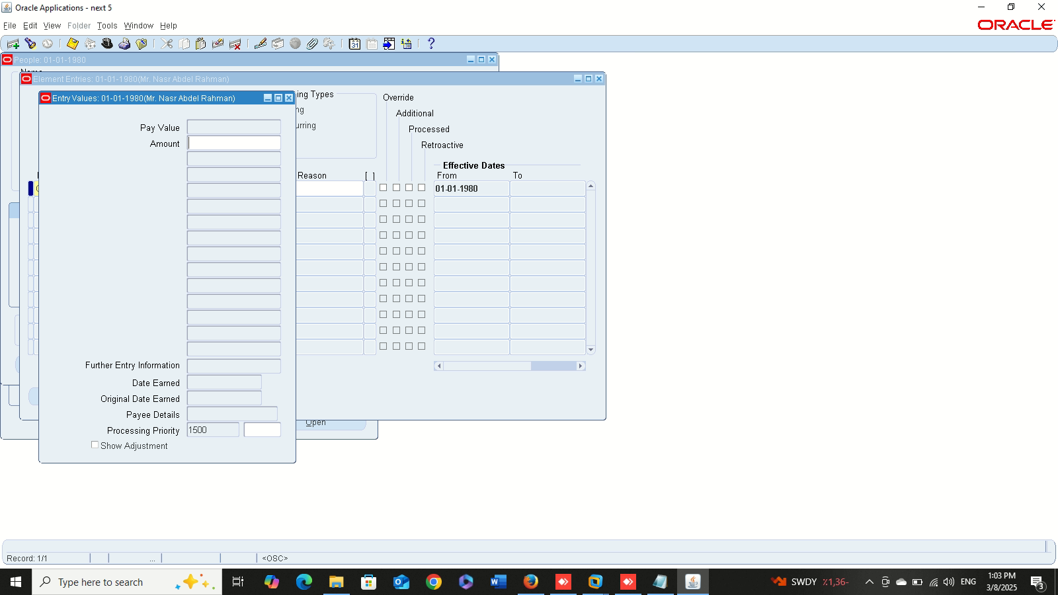
Input Value
Finance Management (Payroll)
Input Value
Entries Value :
Add element to employee
Entries Value
1
2

Slide 15
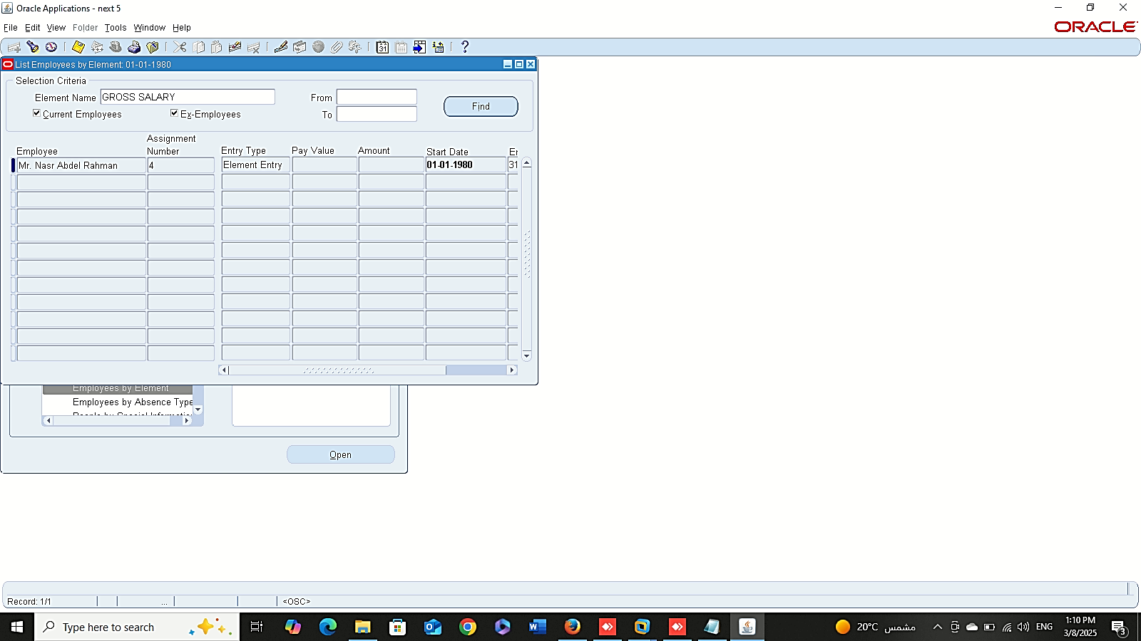
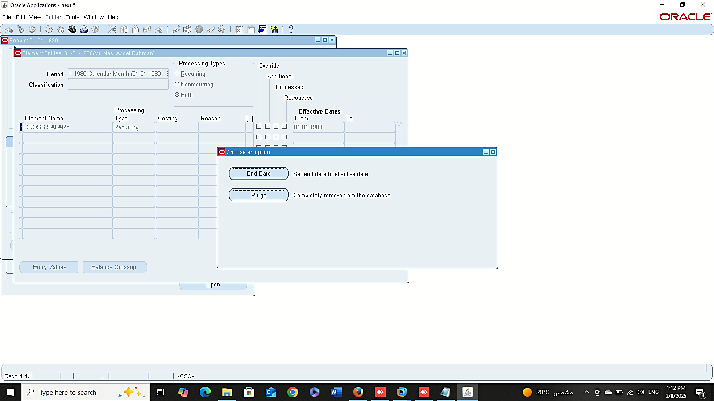
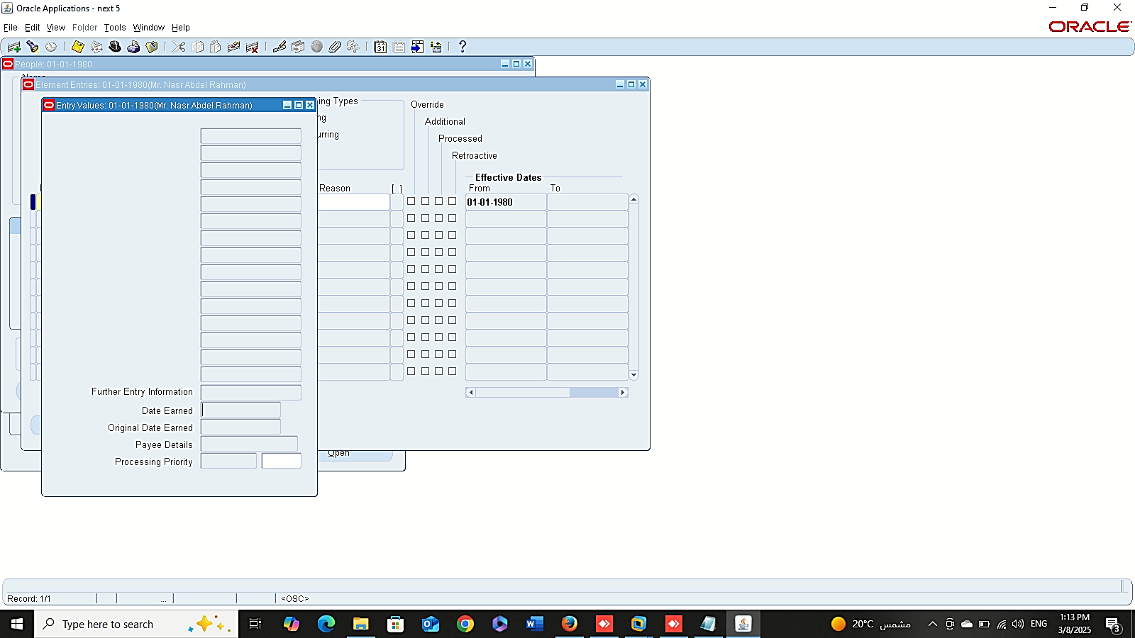
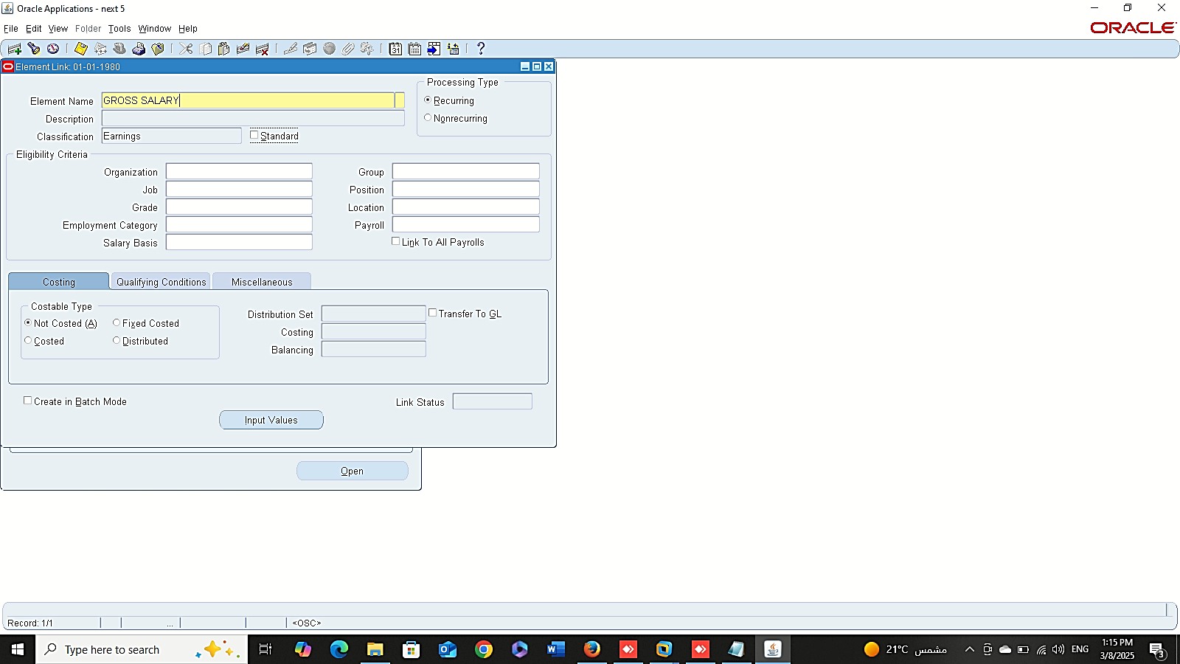
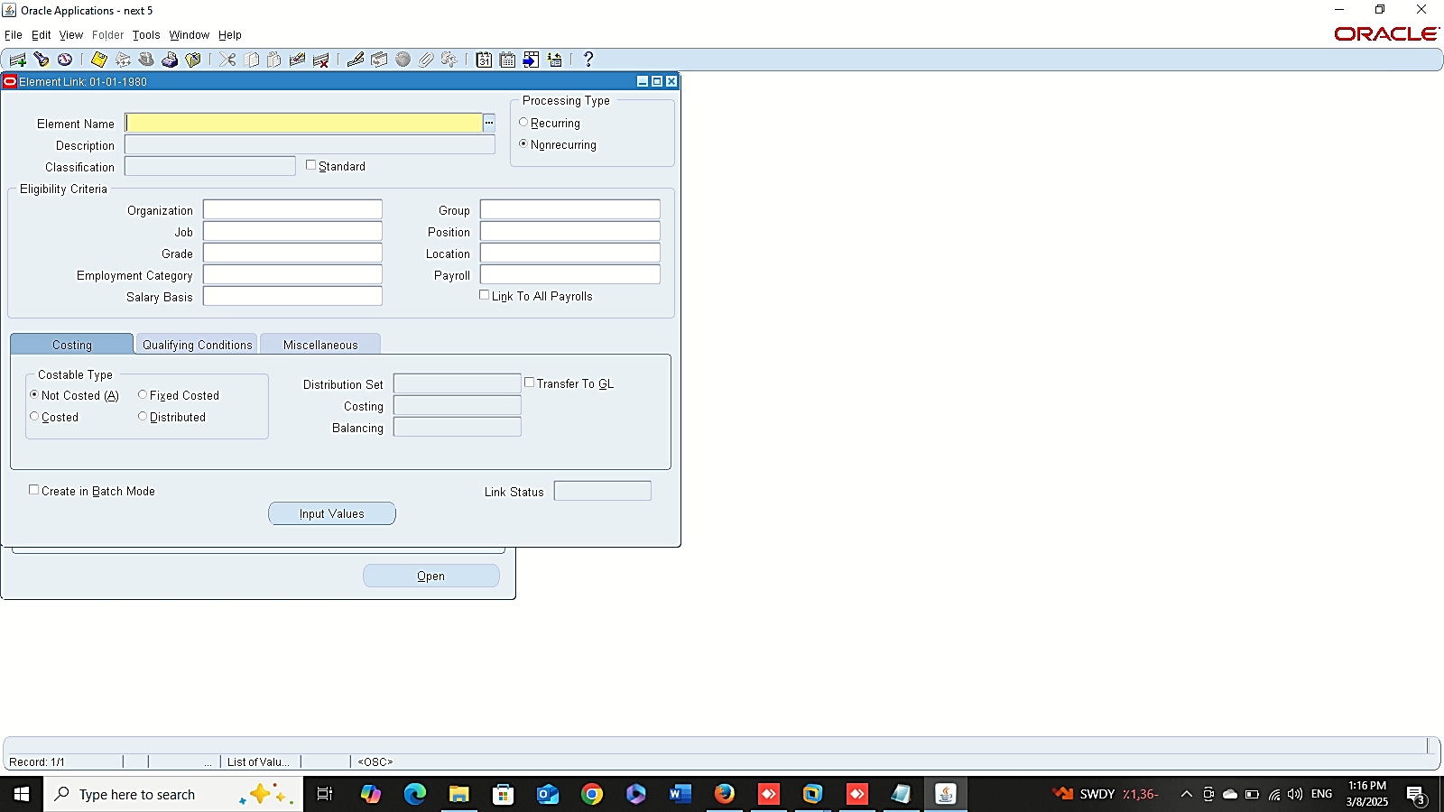
Delete Entries
Finance Management (Payroll)
Delete Elements:
1- Delete Entries:
Global HRMS MANAGER > VIEW LISTS > EMPLOYEES BY ELEMENT
2- Delete Links:
GLOBAL HRMS MANAGER > TOTAL COMPENSATION > BASIC > LINK
Delete Link

Slide 16
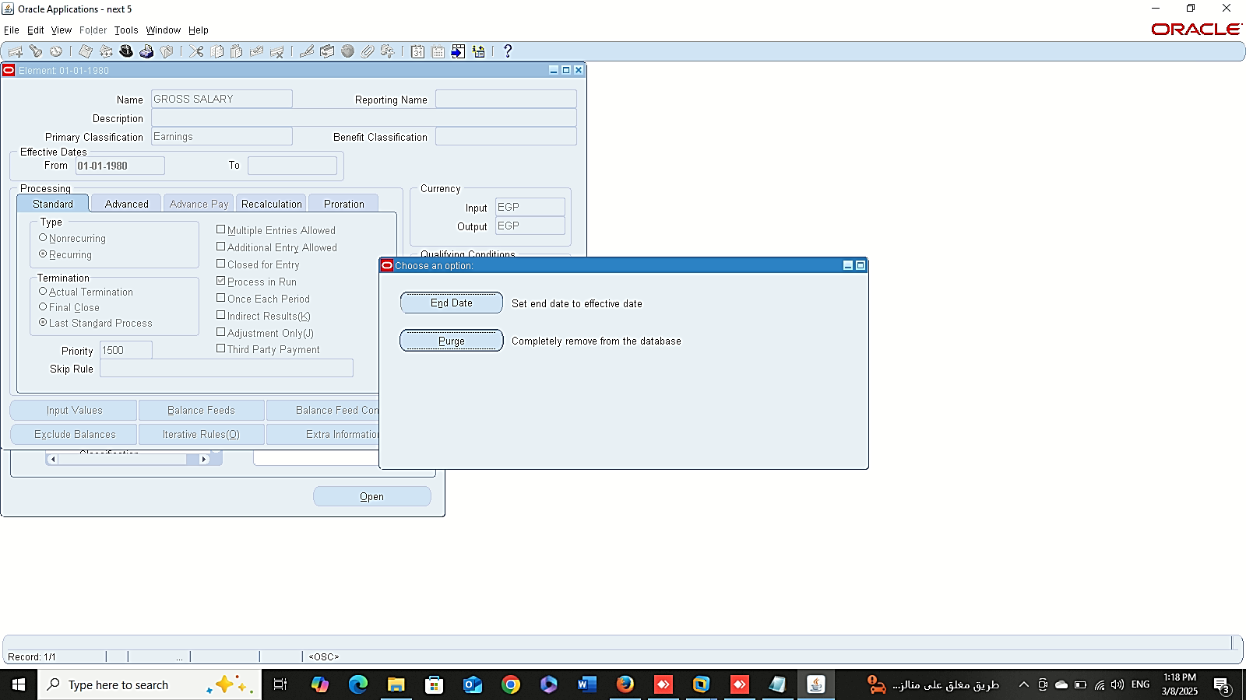
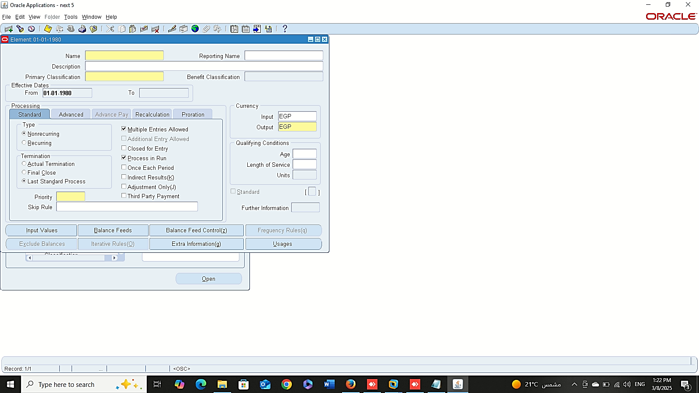
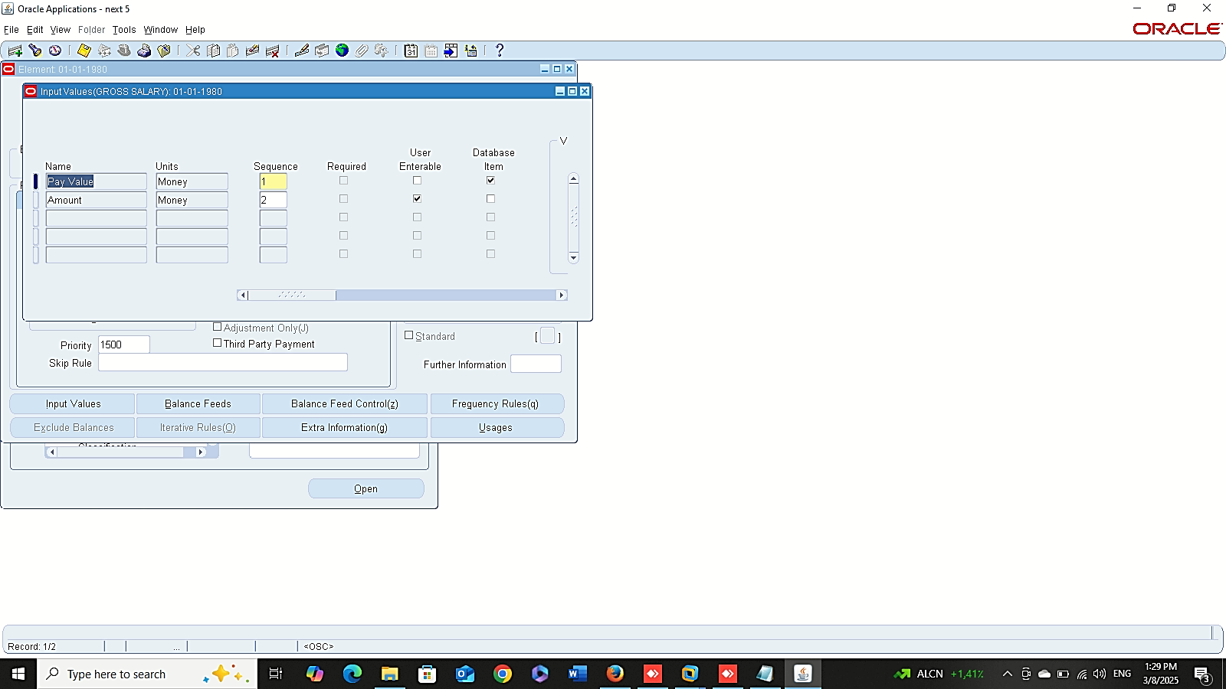


Delete Element
Finance Management (Payroll)
Delete Elements:
3- Delete Element:
GLOBAL HRMS MANAGER > TOTAL COMPENSATION > BASIC > ELEMENT DESCRIPTION
Input Validation
Input Validation

Slide 17




End Date Element
Finance Management (Payroll)
End Date Element
Cancel End Date
Cancel End Date

